Slide 1

Docker
Basic Concepts

Slide 2
Architecture
Devops.Course

Slide 3
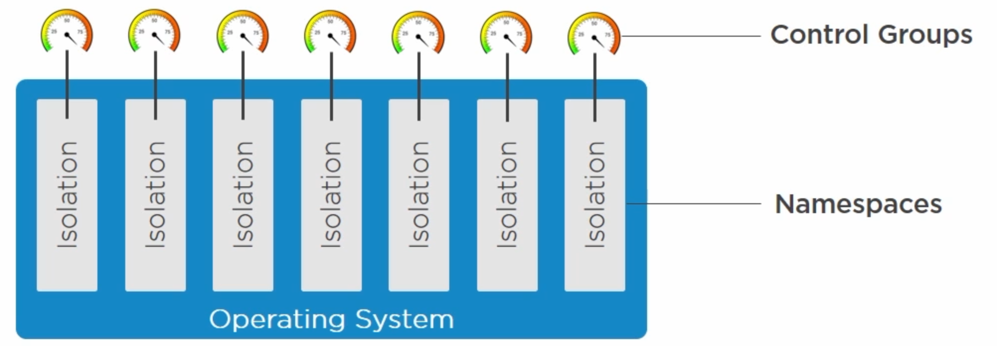
Docker Commands
Container Itself

Slide 4
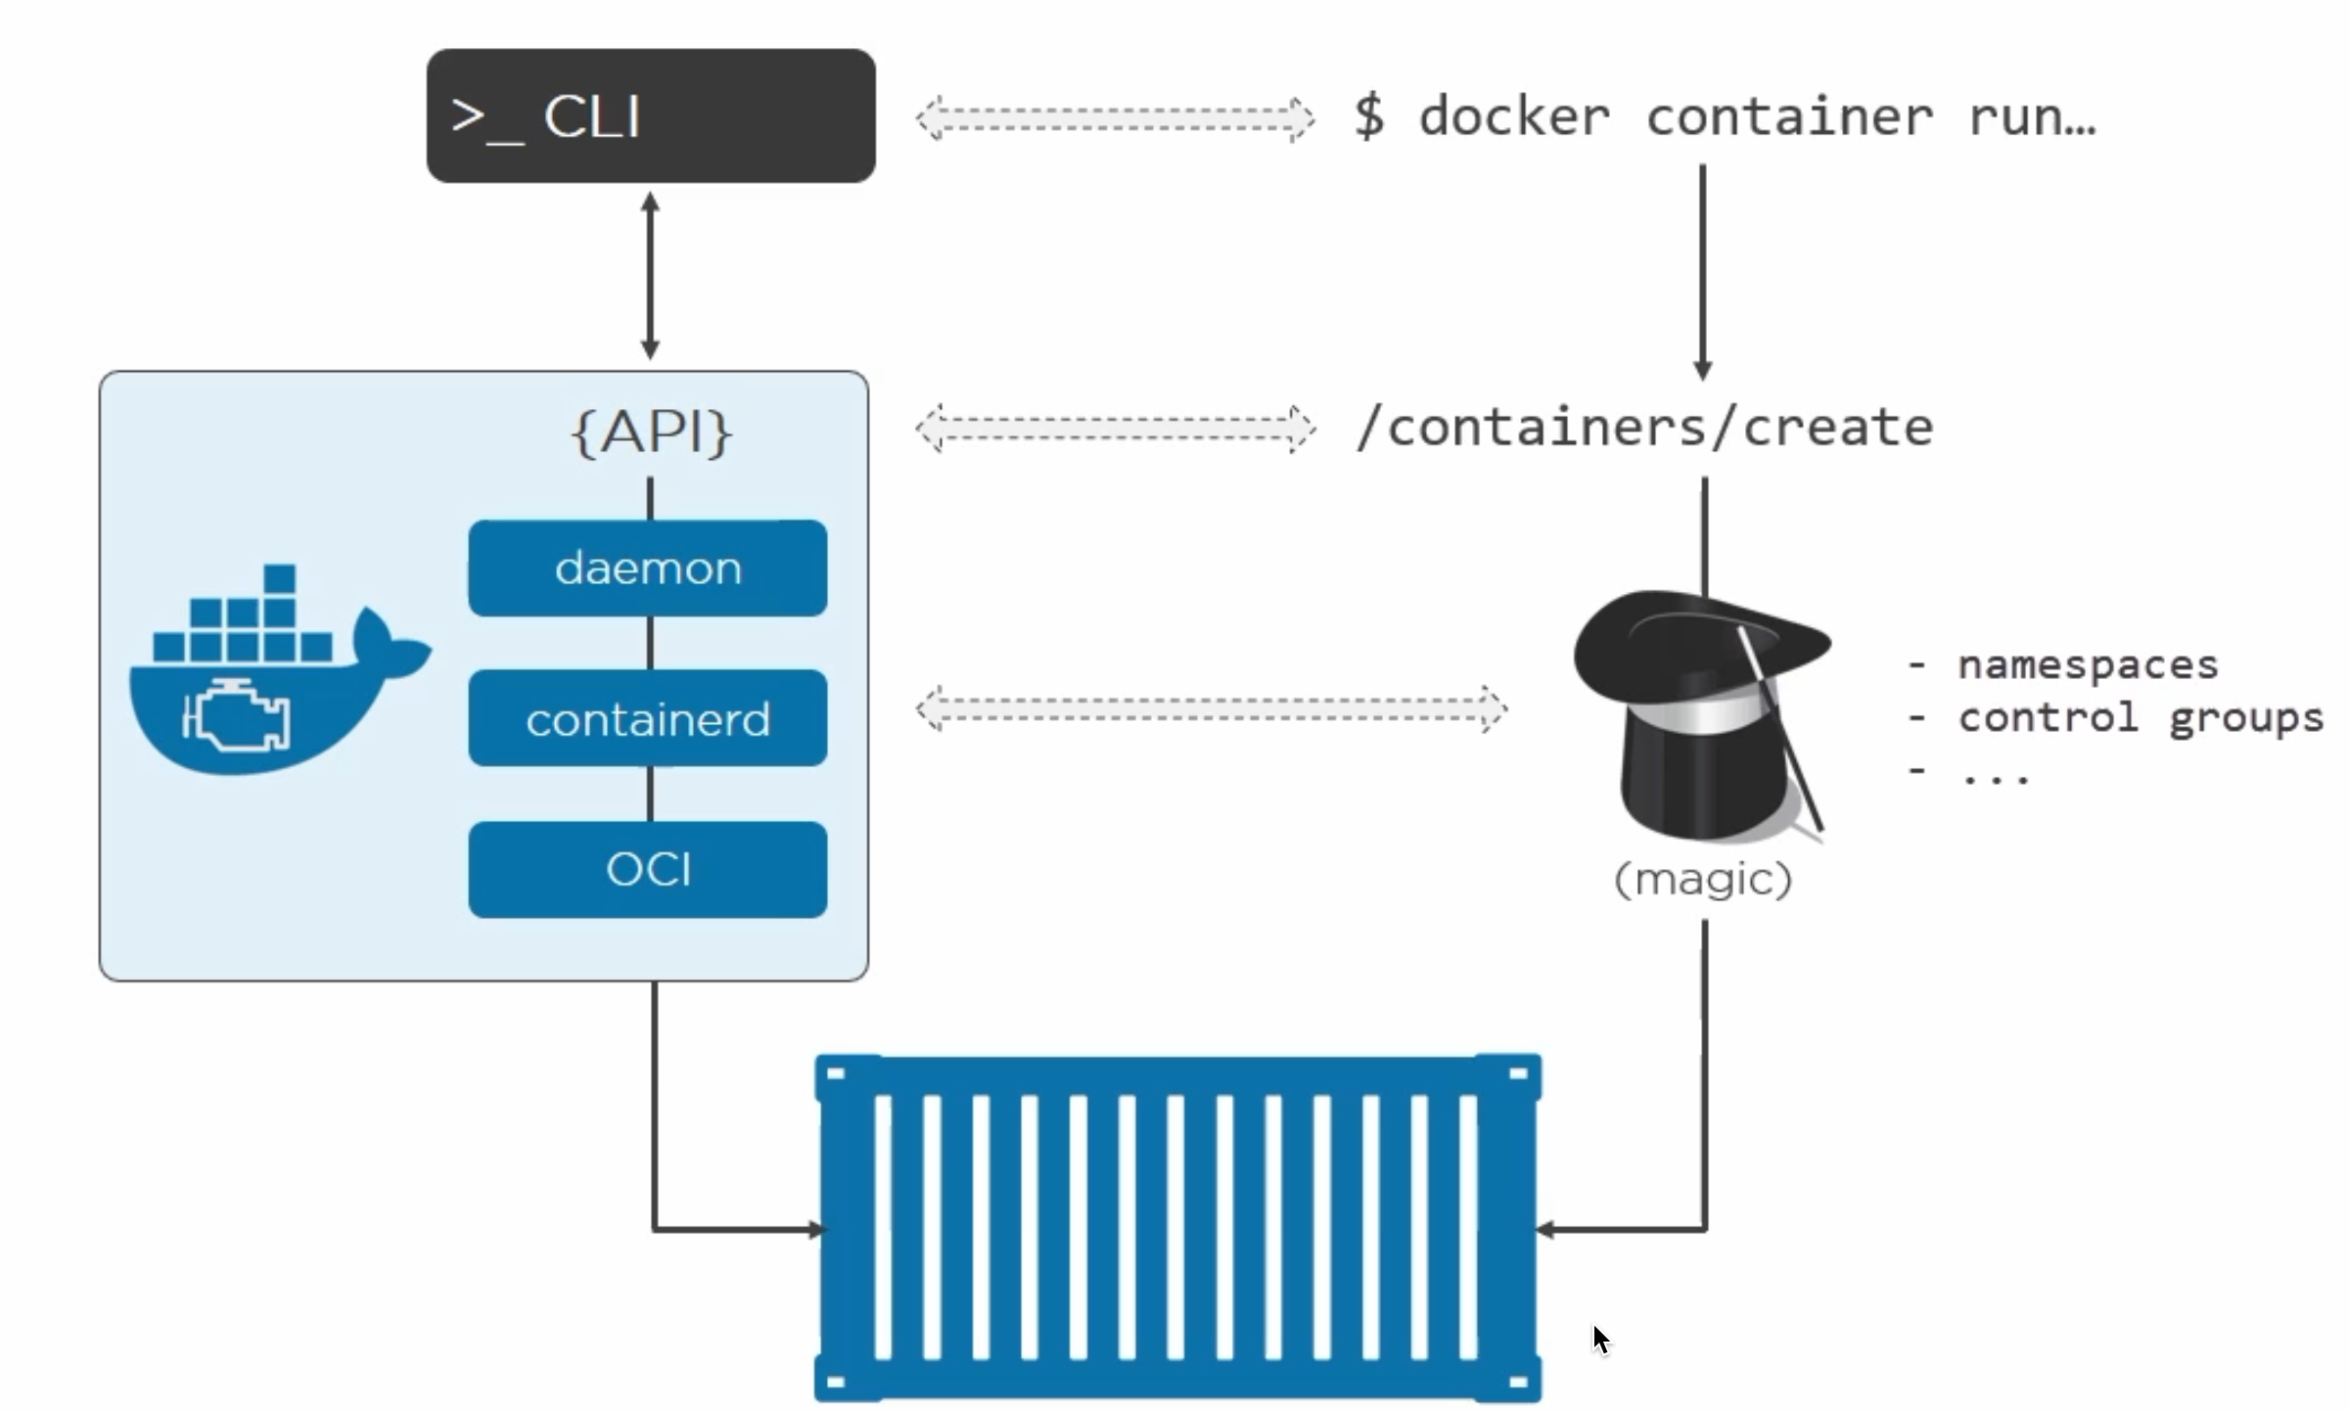
Docker Commands
Magic …

Slide 5
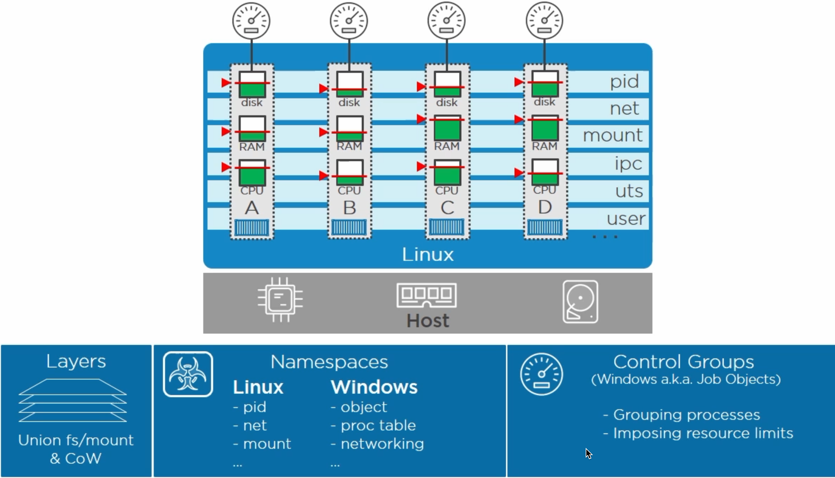
Docker Commands
Linux and Windows

Slide 6
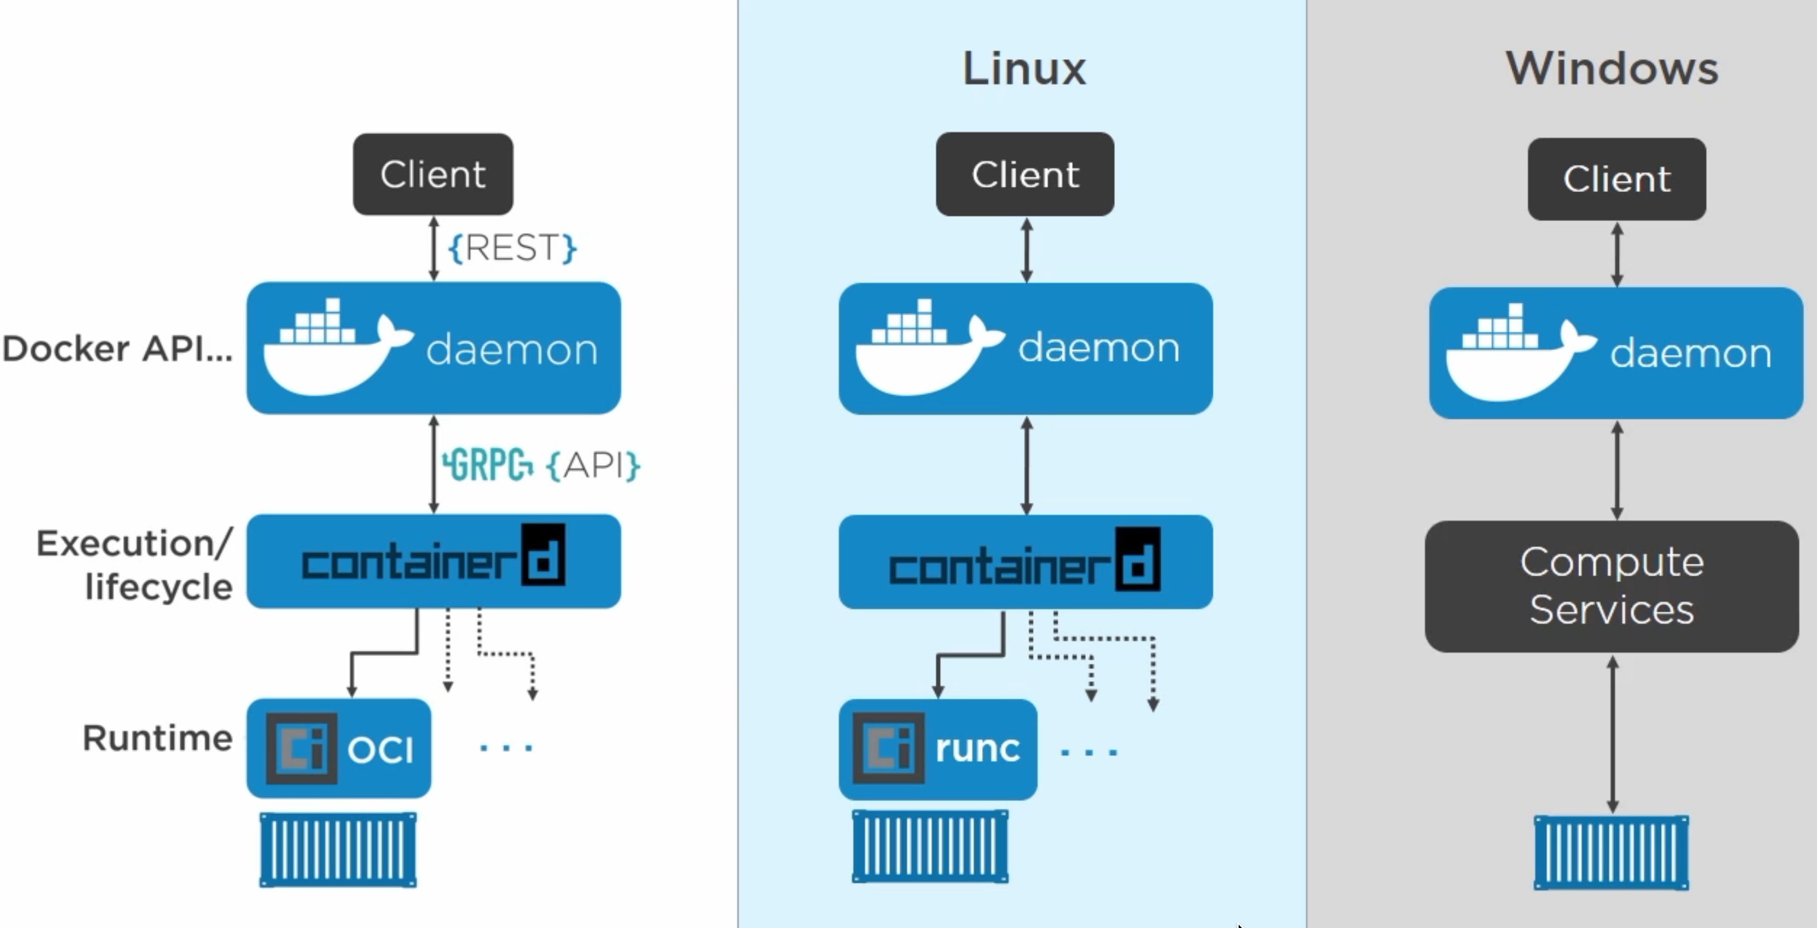
Docker Commands
Docker Engine

Slide 7
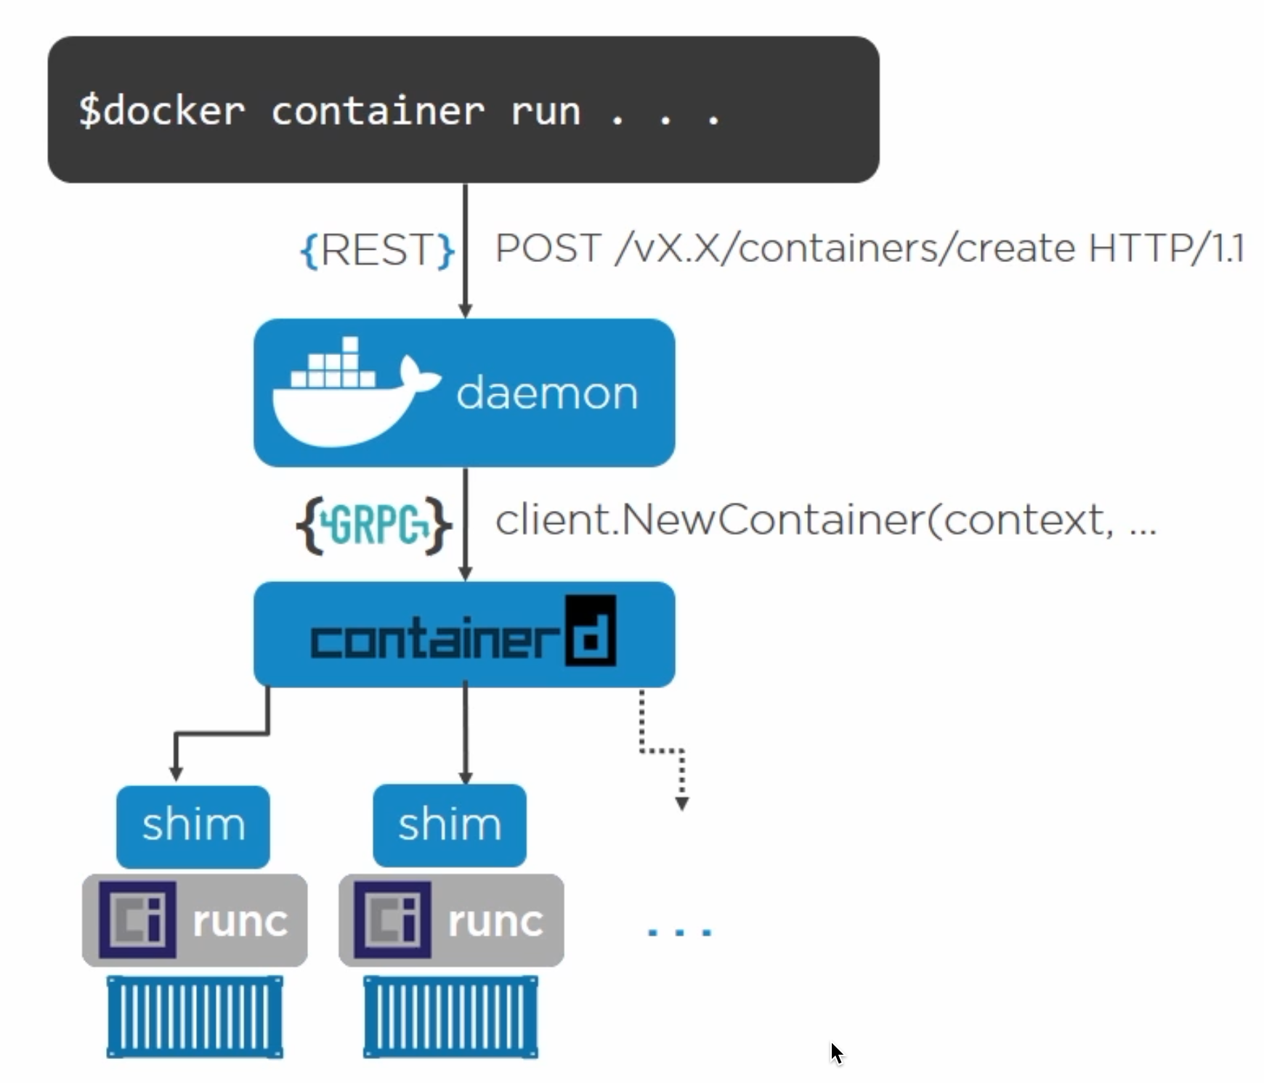
Docker Commands
Docker Engine

Slide 8
Images
Devops.Course

Slide 9
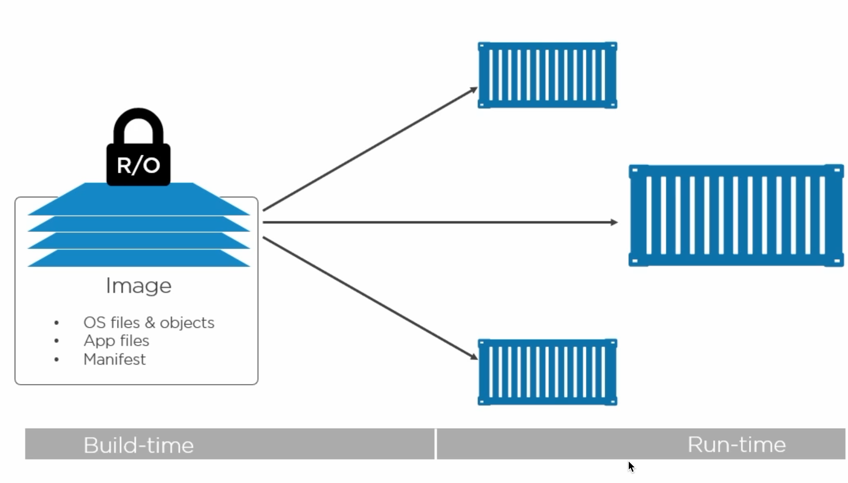
Docker Commands
Docker Images

Slide 10
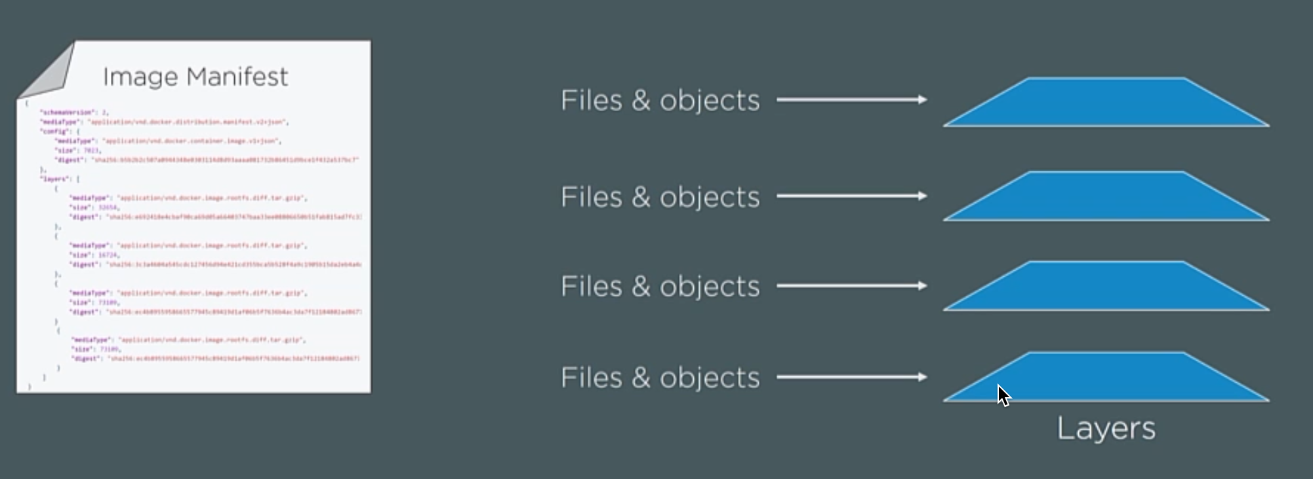
Docker Commands
Image Itself

Slide 11
Pull Manifest
2. Pull Layers
Image Itself

Slide 12
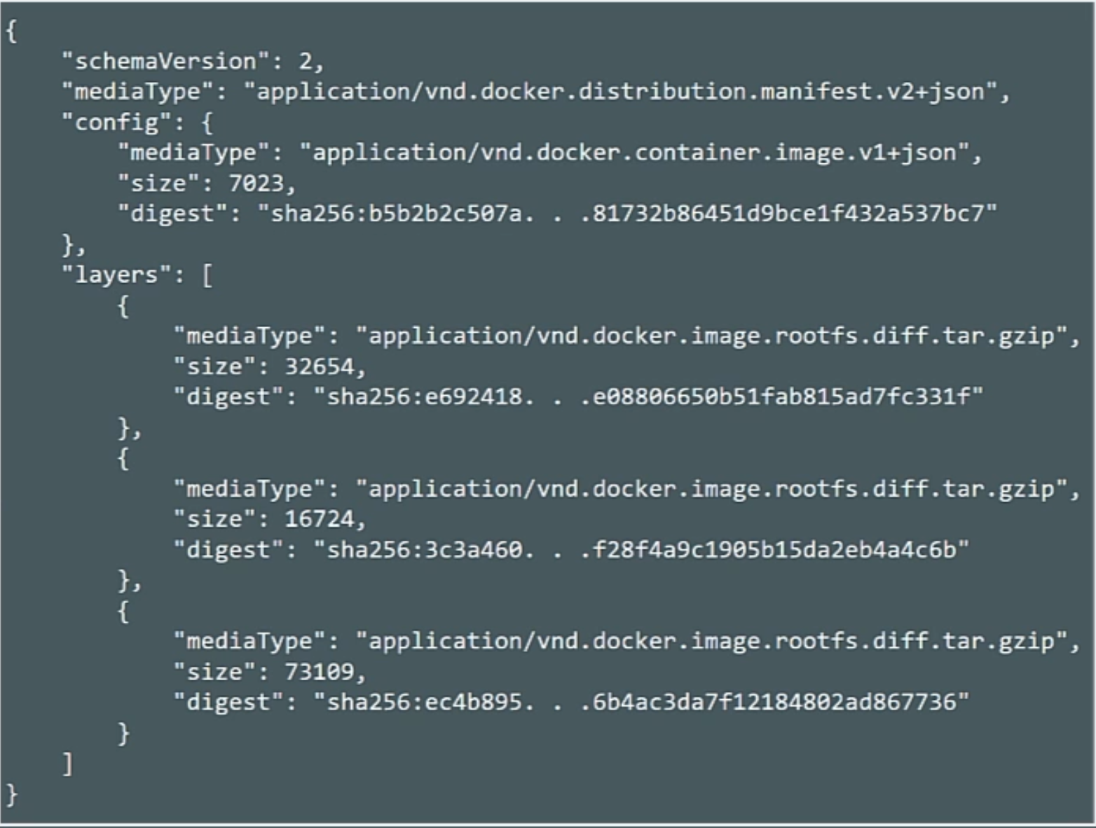
Docker Commands
Manifest

Slide 13
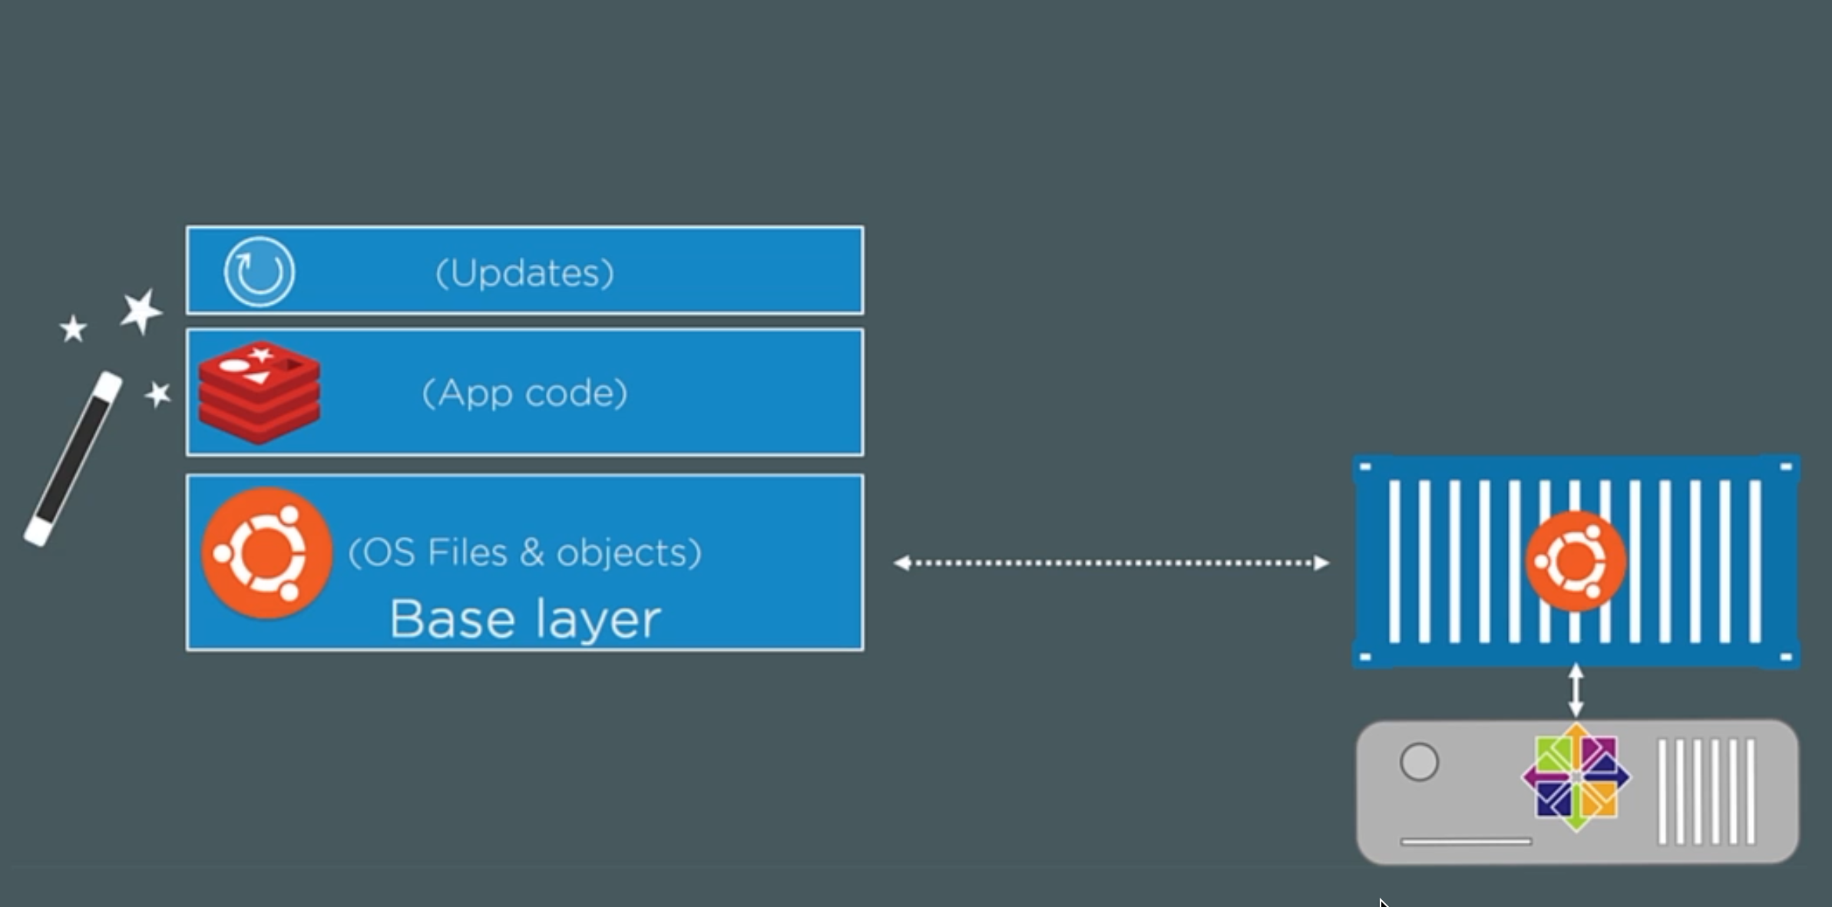
Docker Commands
Layers

Slide 14
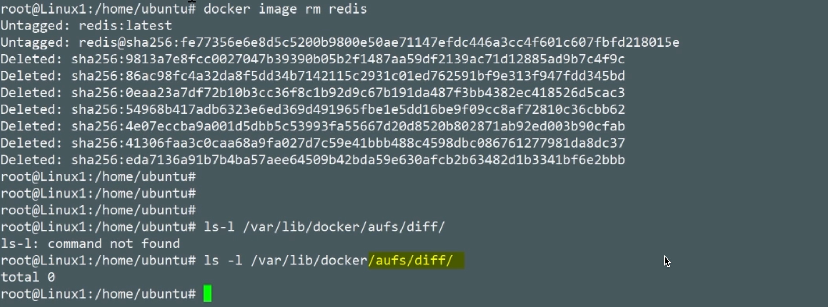
Docker Commands
Where Layers Lives

Slide 15
Registry
Devops.Course

Slide 16
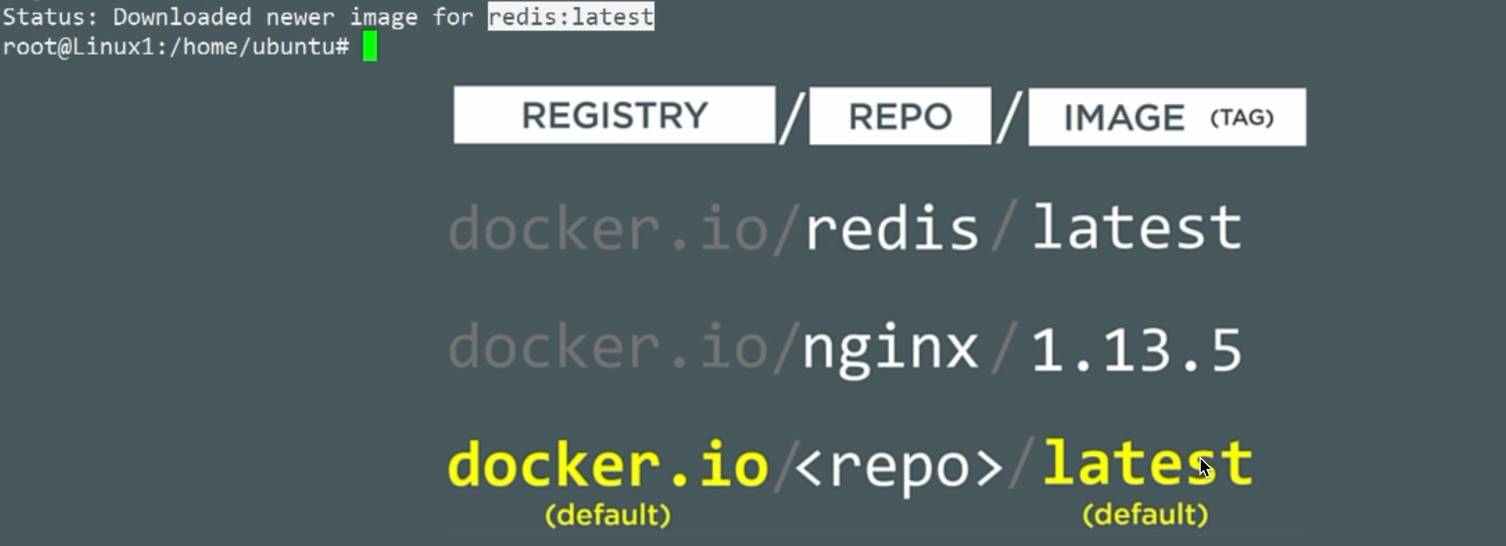
Pull Manifest
Pull Layers
Registry

Slide 17
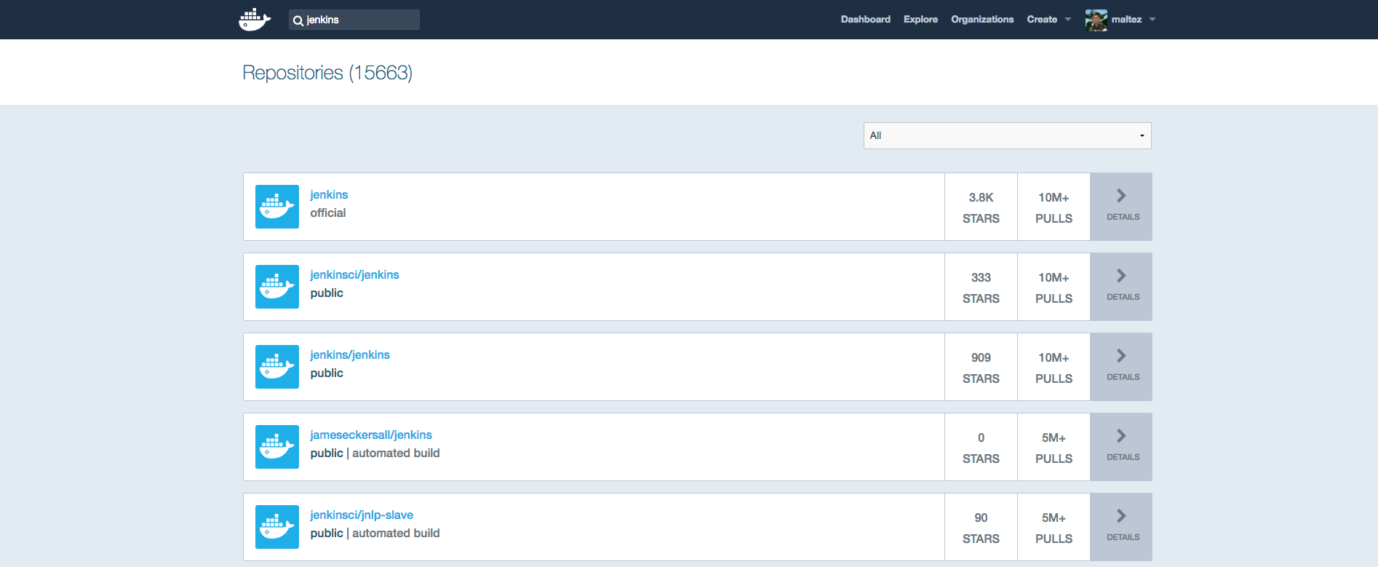
Docker Commands
Devops.Events

Slide 18
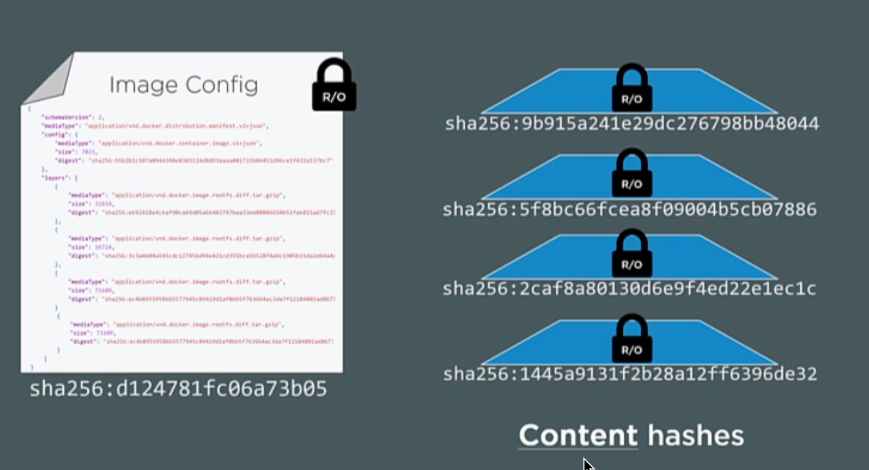
Pull Manifest
Pull Layers
Security

Slide 19
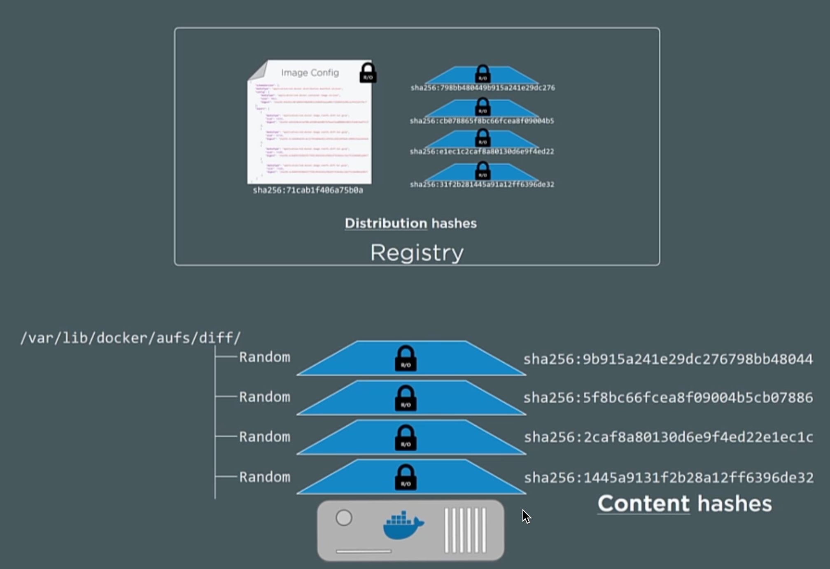
Pull Manifest
Pull Layers
Security

Slide 20
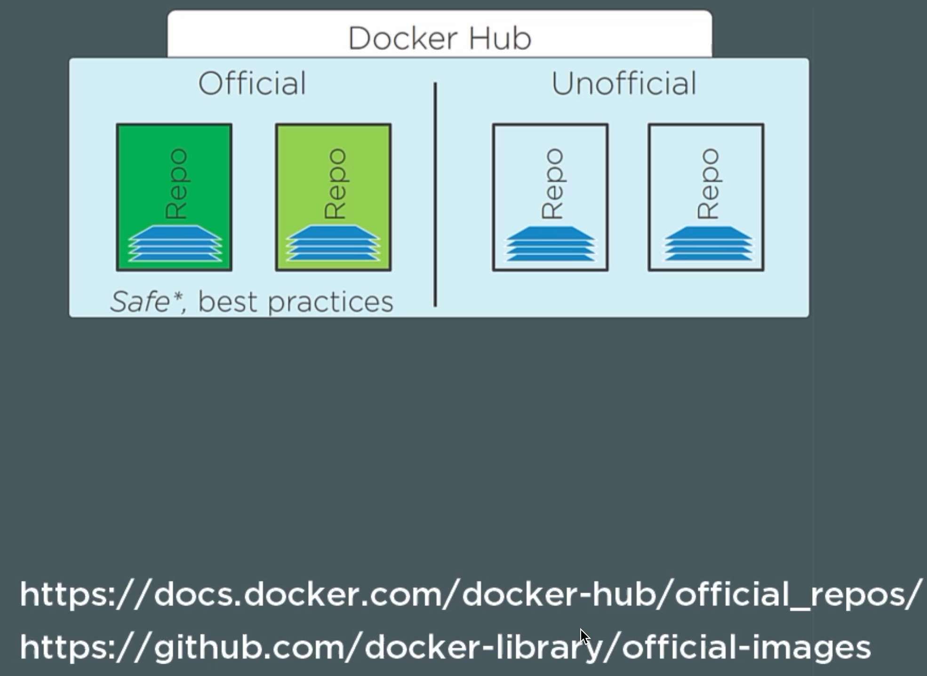
Pull Manifest
Pull Layers
Security

Slide 21
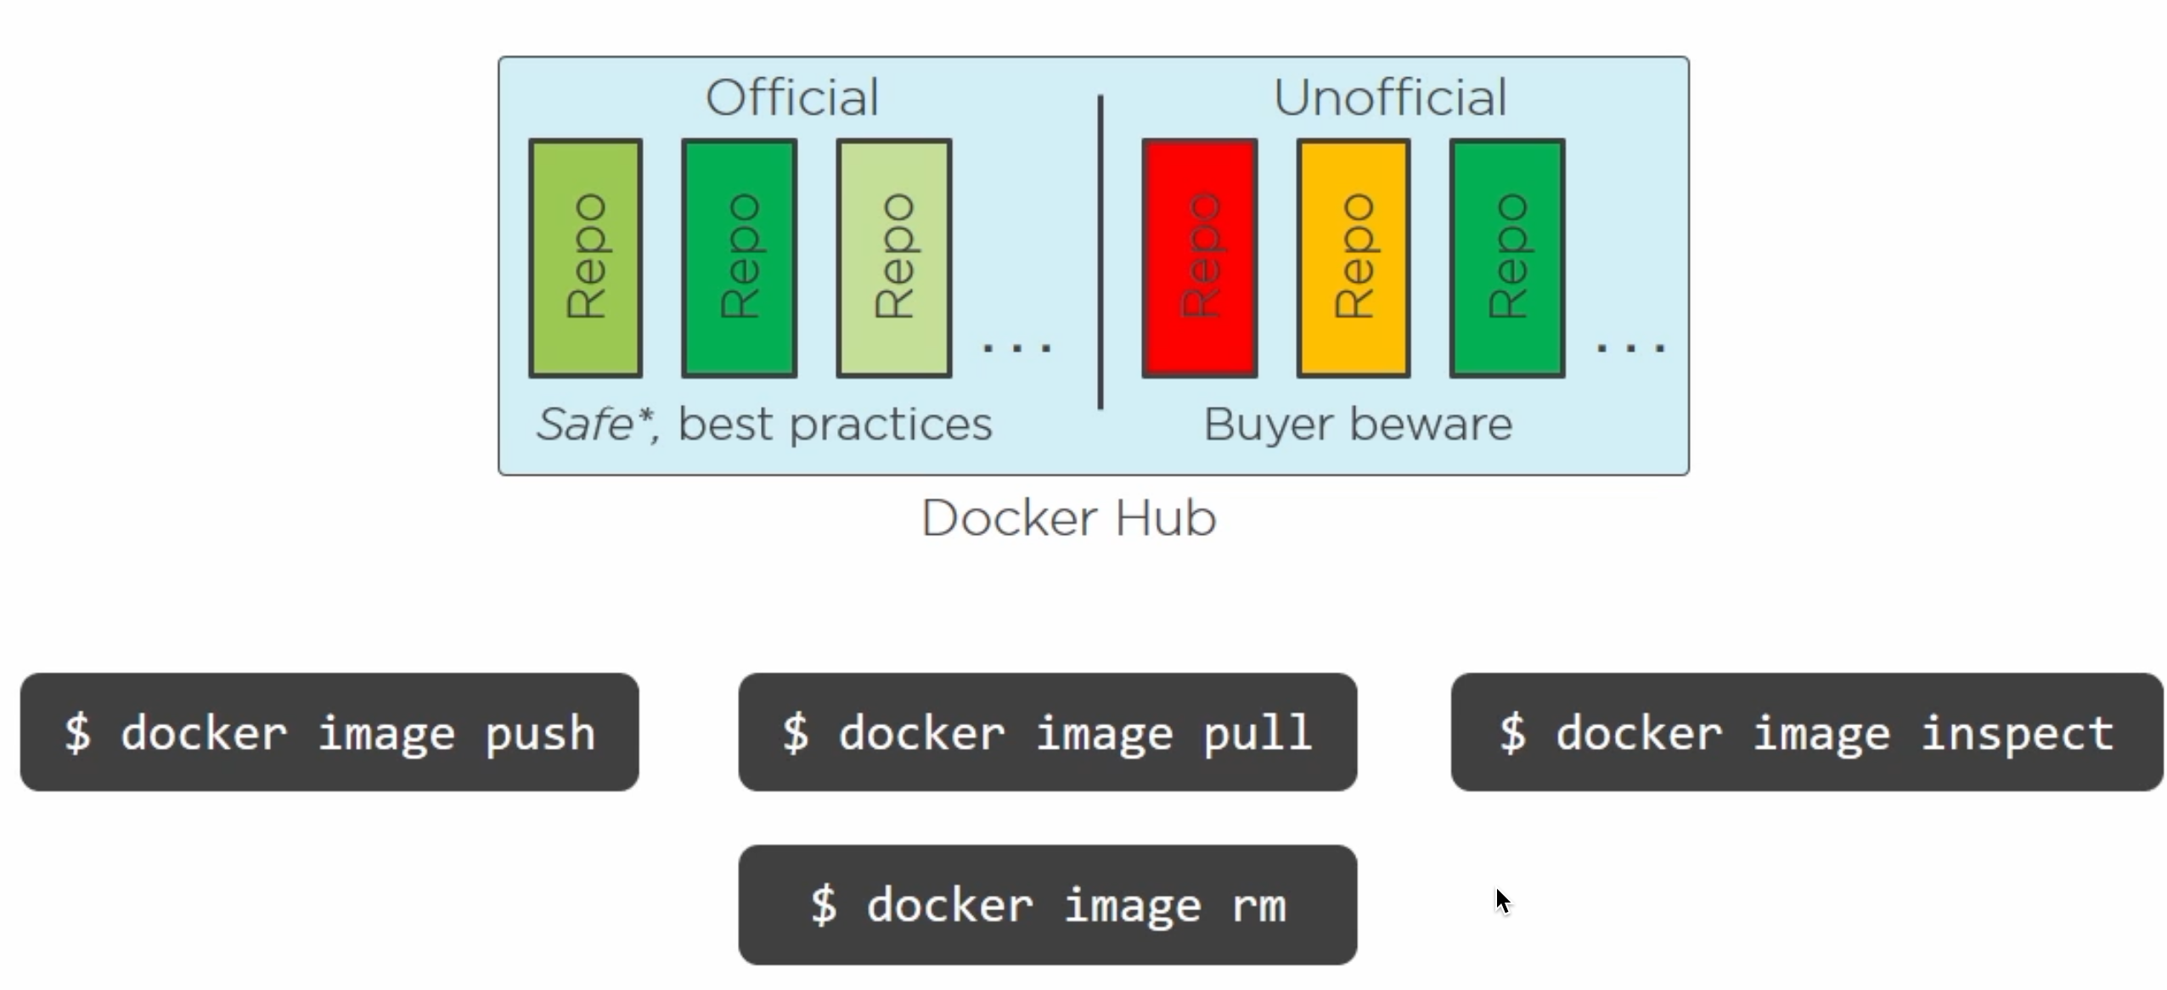
Pull Manifest
Pull Layers
Image command

Slide 22
Dockerfile
Devops.Course

Slide 23
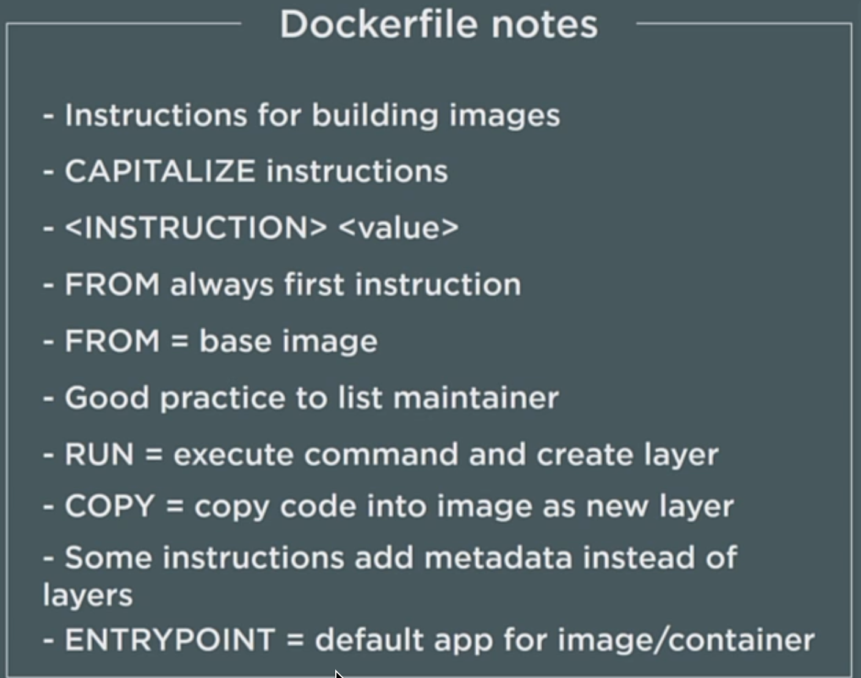
Pull Manifest
Pull Layers
Image command

Slide 24
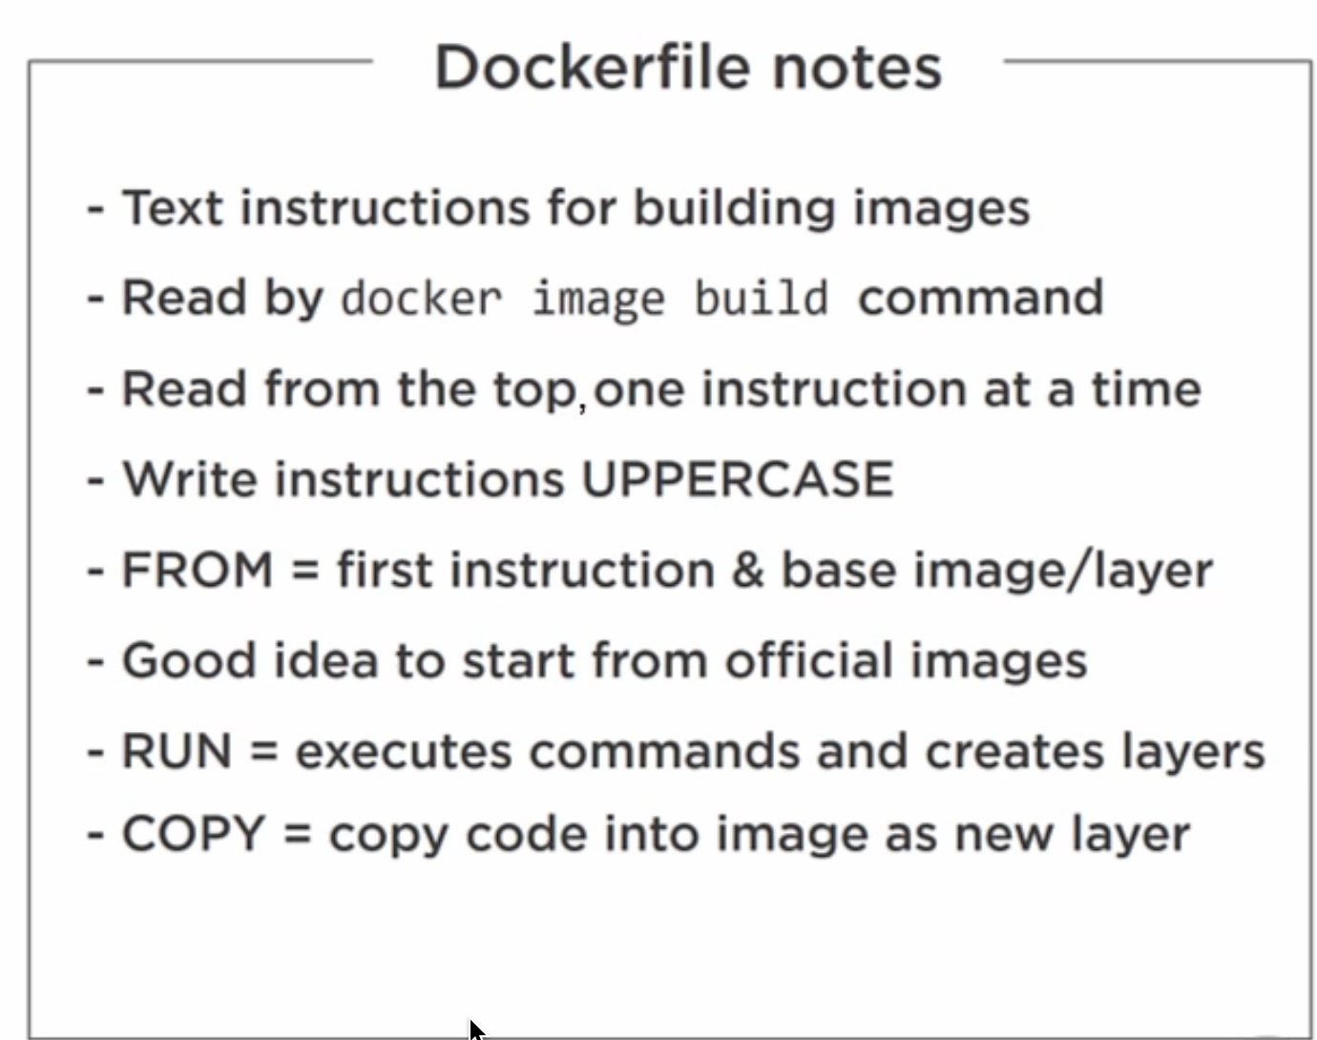
Pull Manifest
Pull Layers
Image command

Slide 25
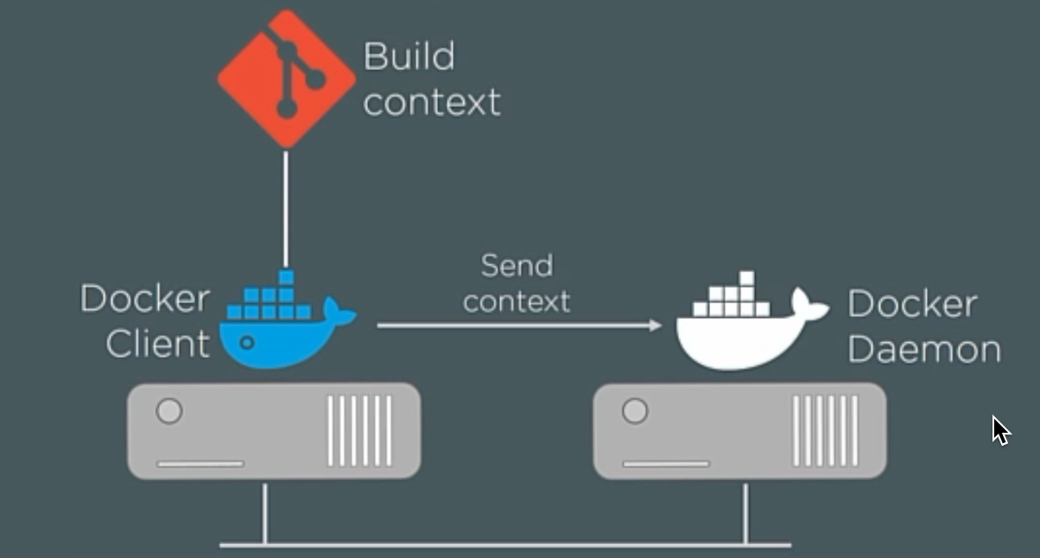
Pull Manifest
Pull Layers
Build context

Slide 26
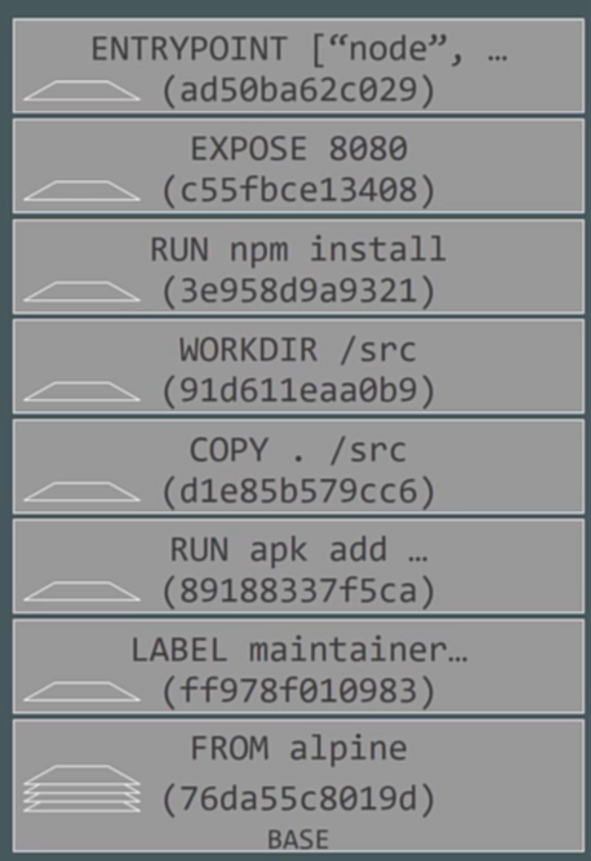
Pull Manifest
Pull Layers
Build context

Slide 27
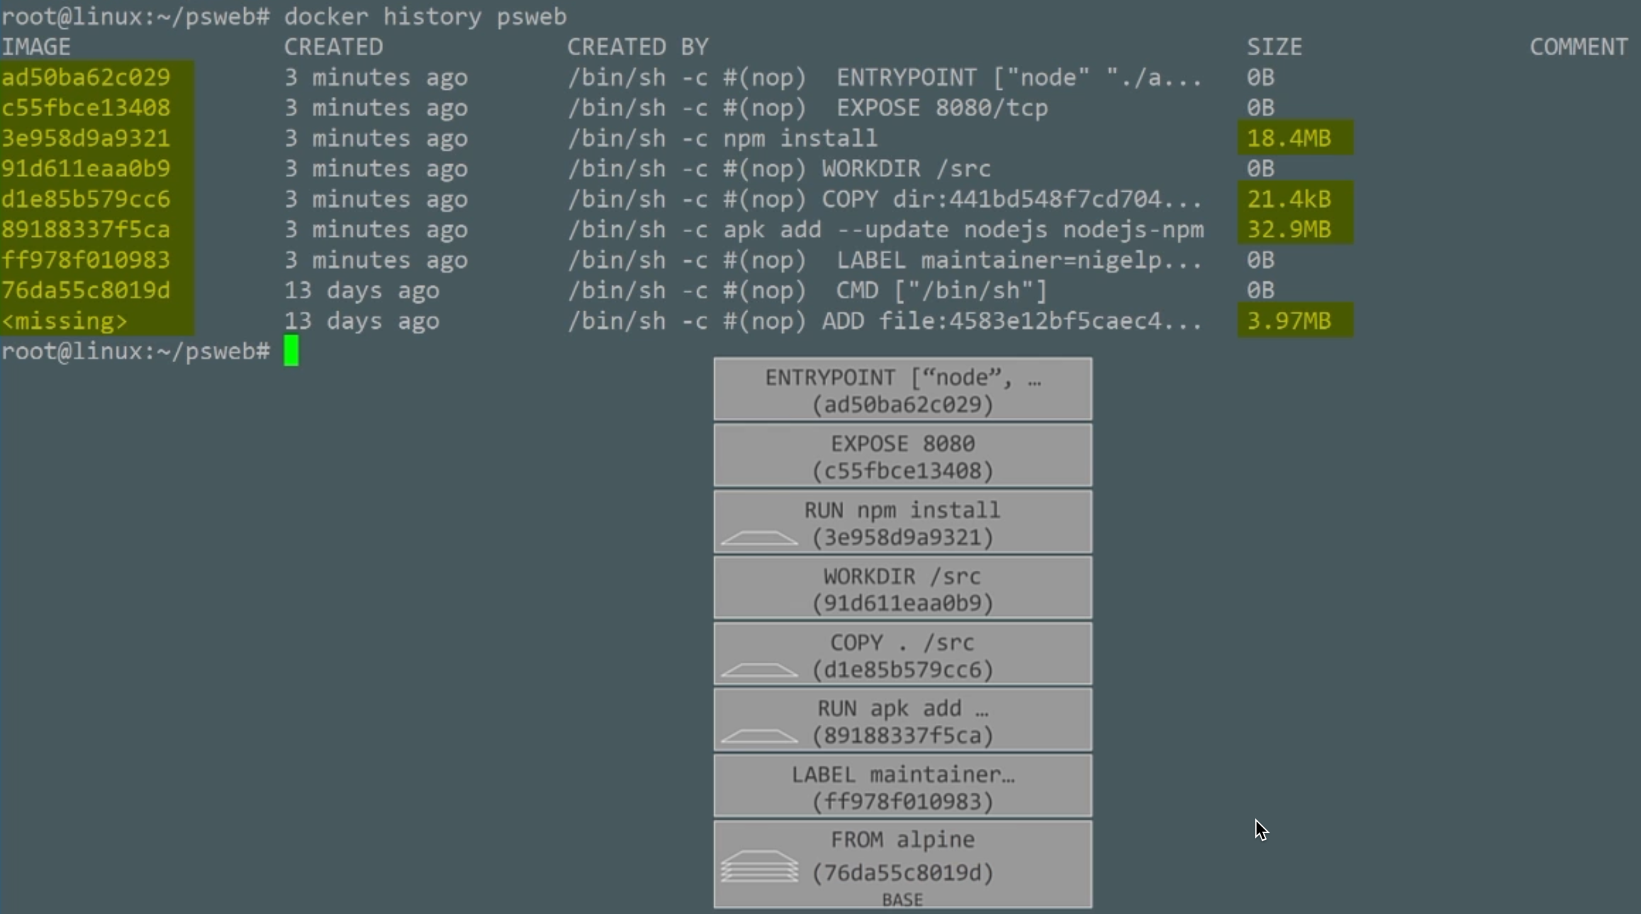
Pull Manifest
Pull Layers
Security

Slide 28
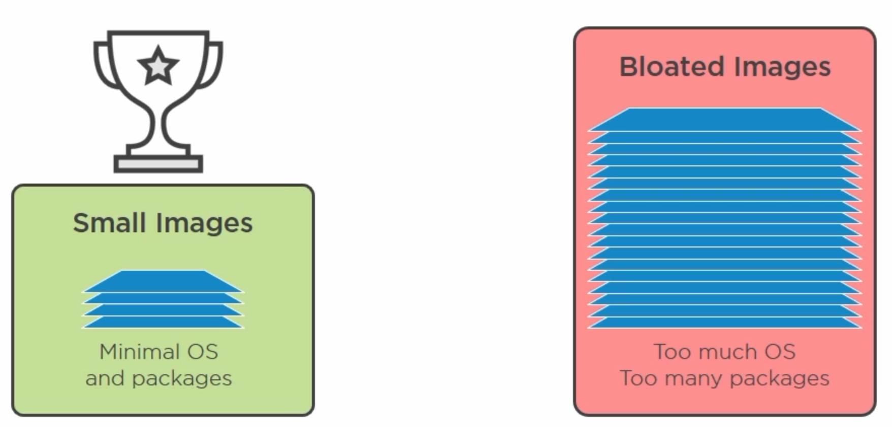
Pull Manifest
Pull Layers
Multistage Builds

Slide 29
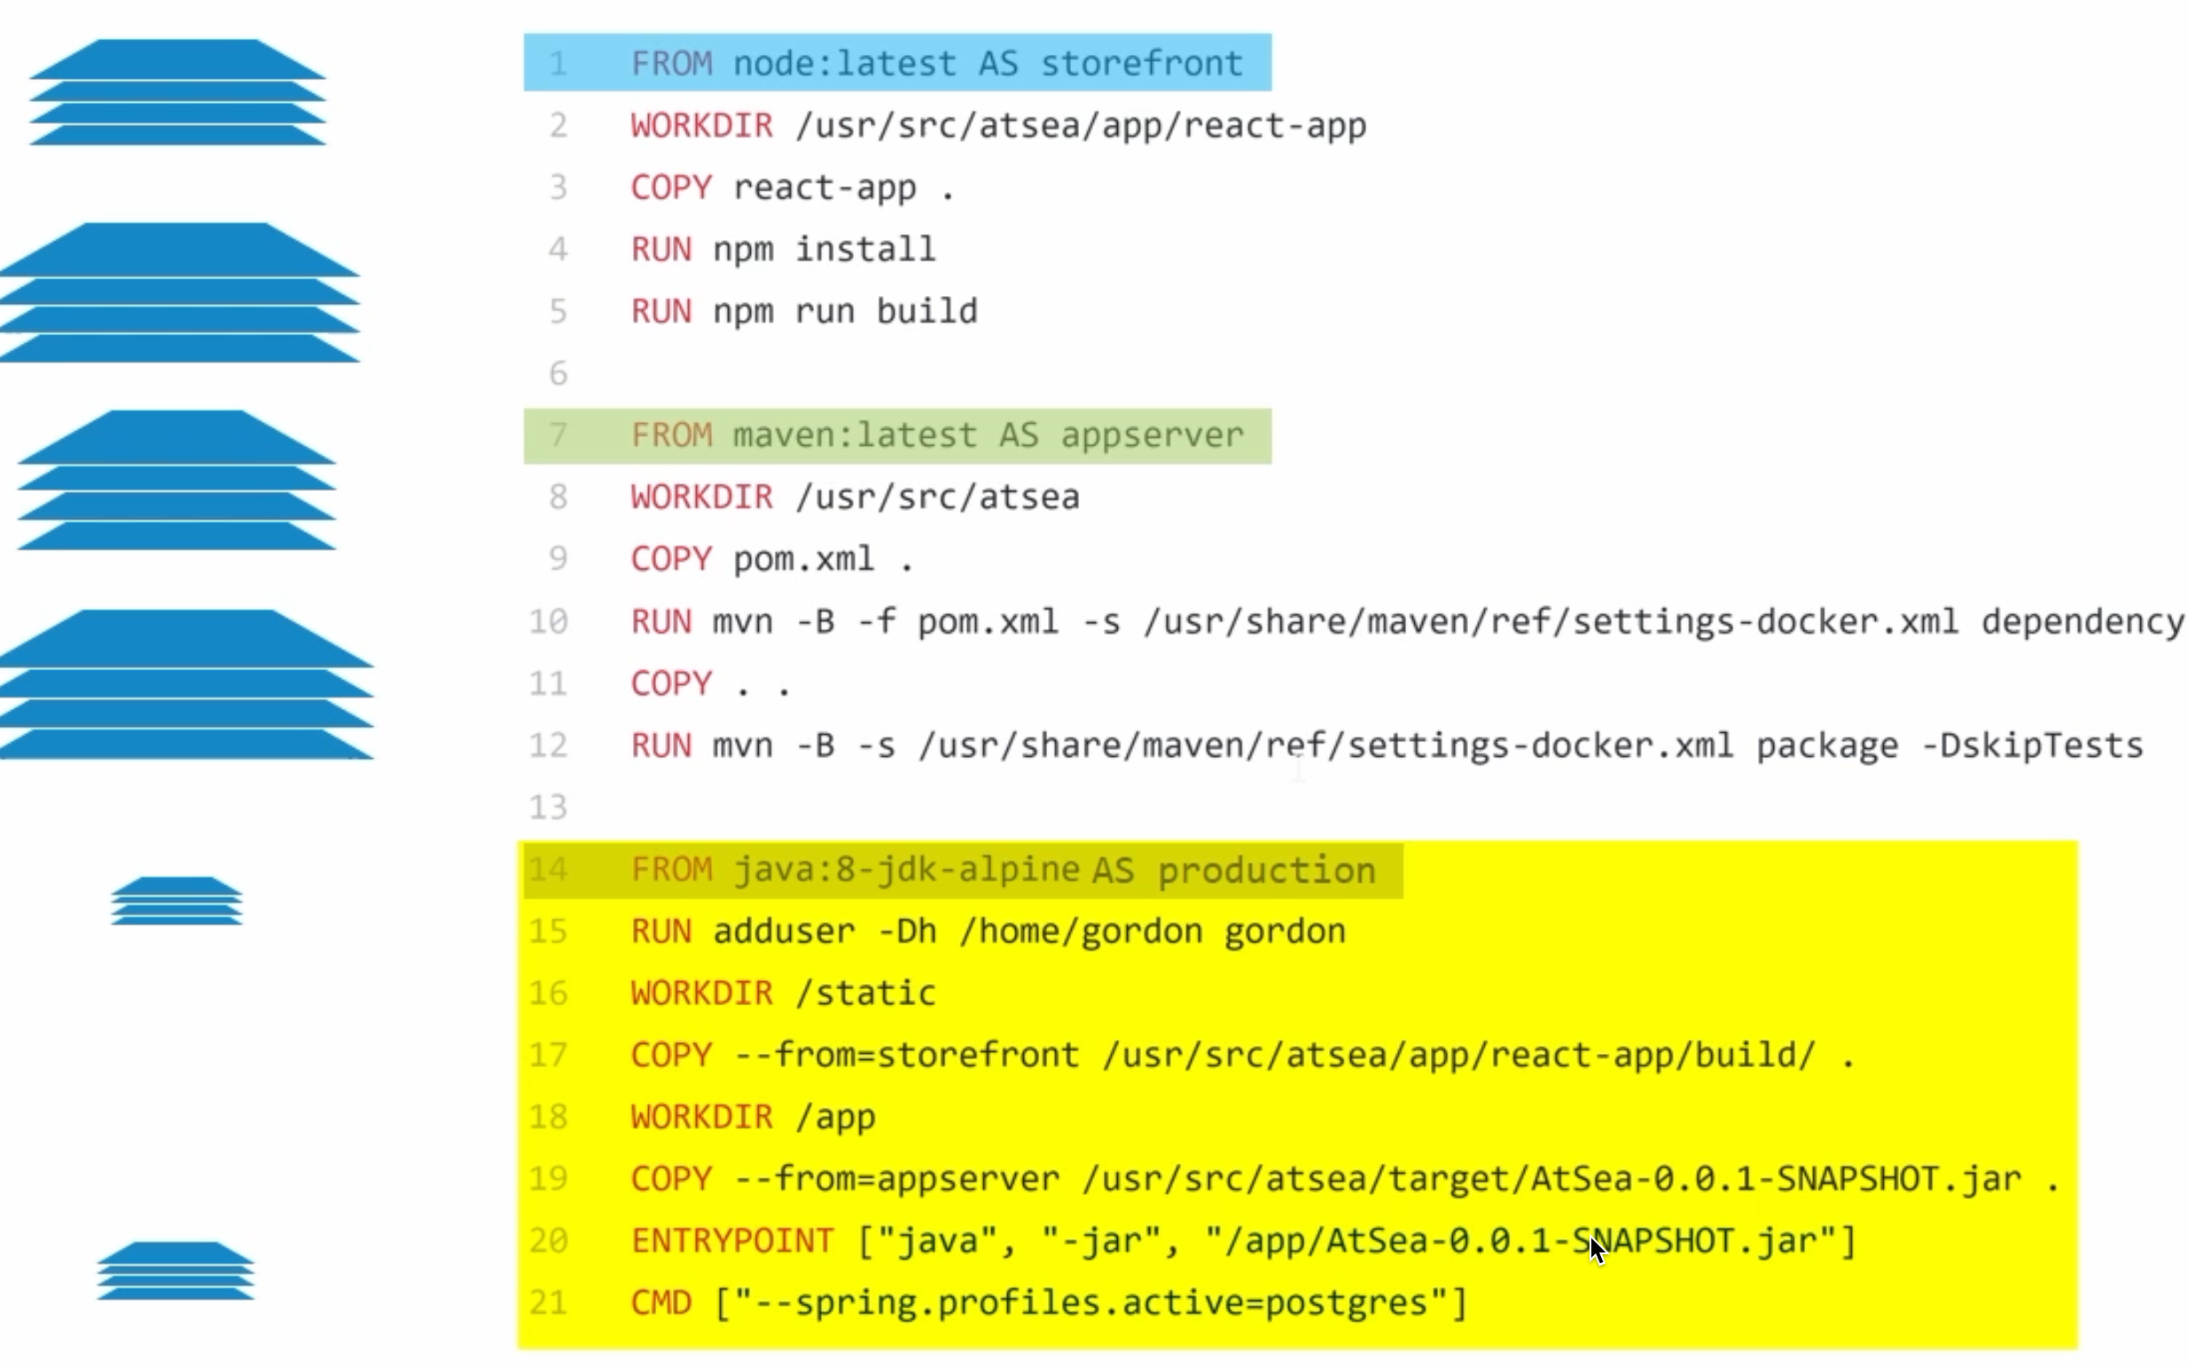
Pull Manifest
Pull Layers
Multistage Builds

Slide 30
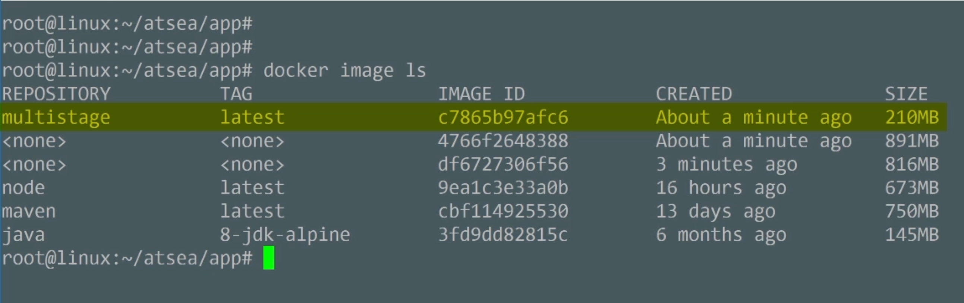
Pull Manifest
Pull Layers
Multistage Builds

Slide 31
Dockerfile best practices
Use a .dockerignore file
Containers should be immutable & ephemeral
Minimize the number of layers / Consolidate instructions
Avoid installing unnecessary packages
Sort multi-line arguments
Build cache
Build every time
Dockerfile for Development Environment
Understand CMD and ENTRYPOINT
Devops.Events

Slide 32
Containers
Devops.Course

Slide 33
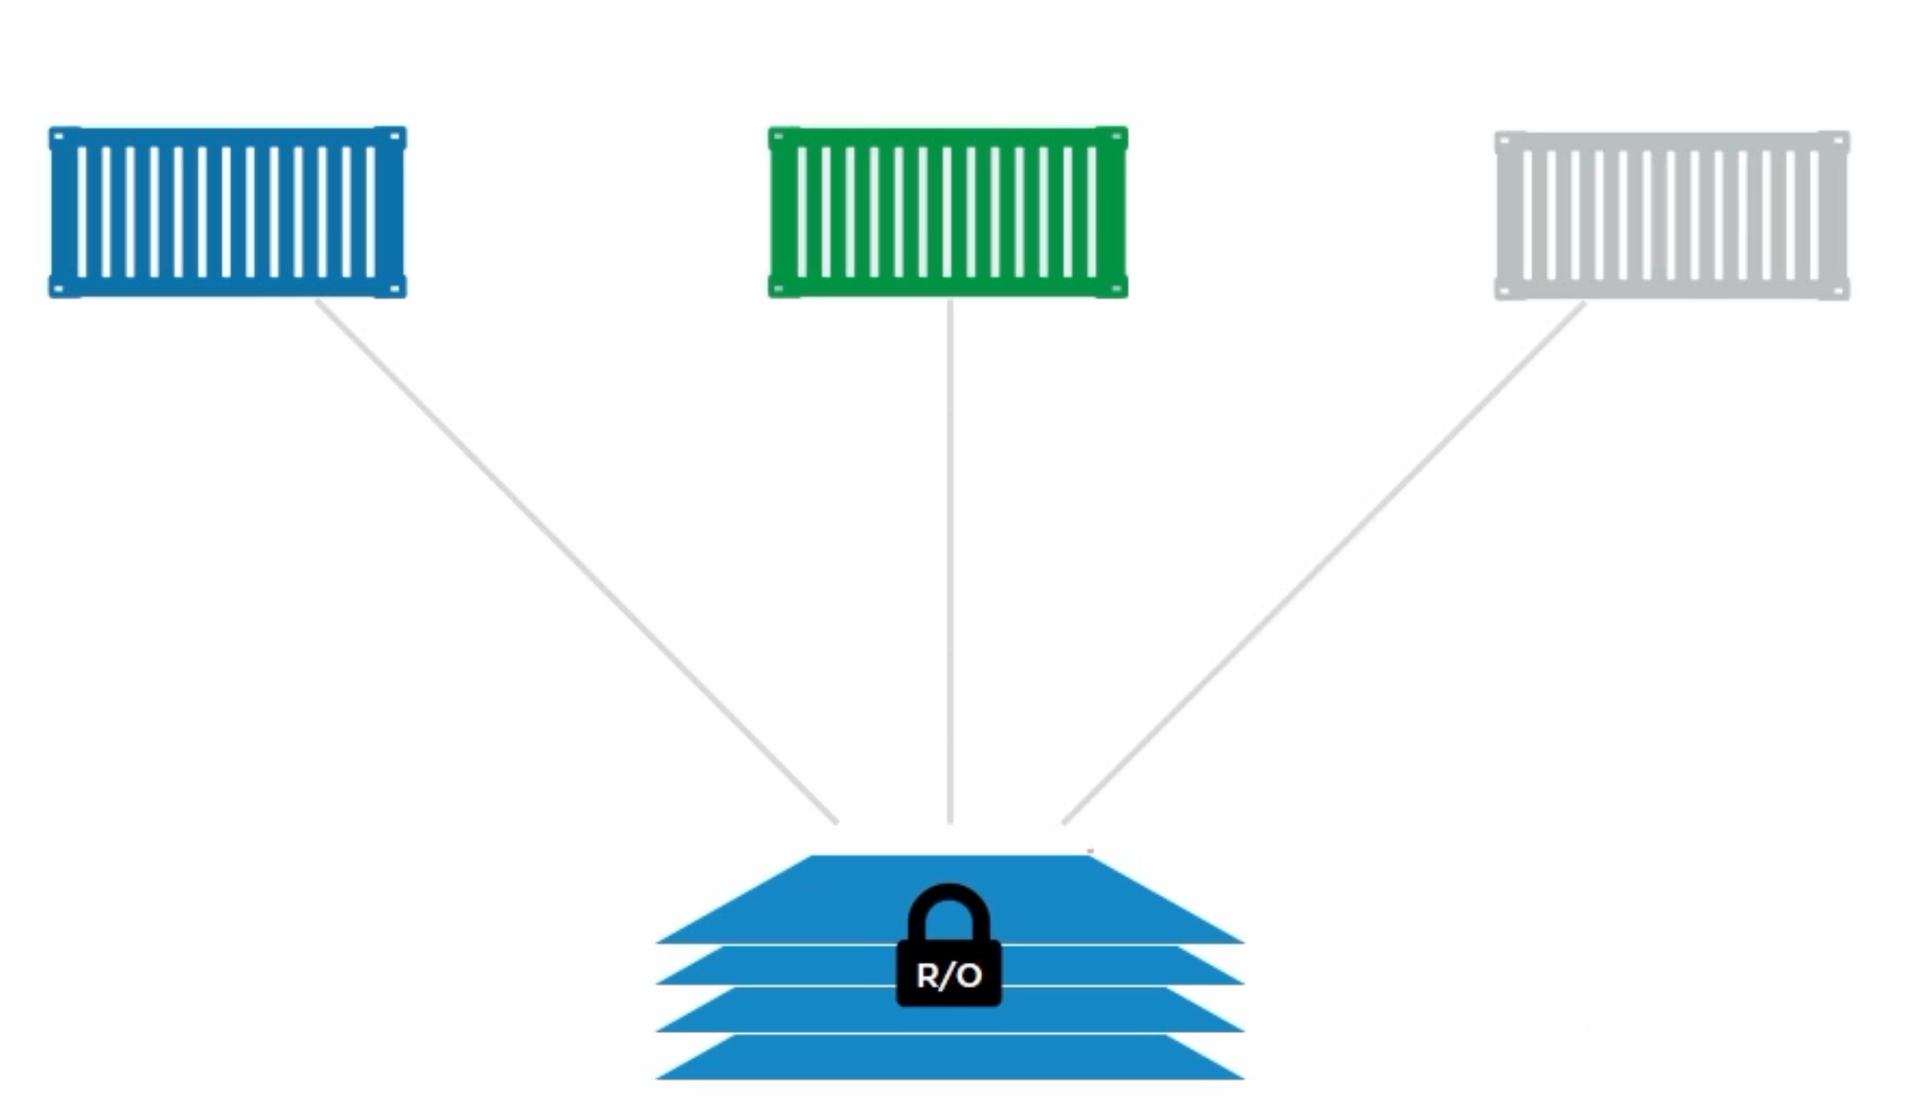
Pull Manifest
Pull Layers
Containers

Slide 34
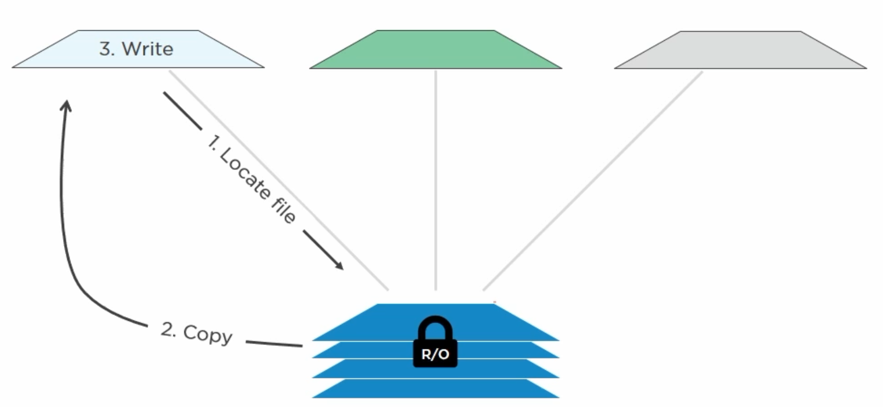
Pull Manifest
Pull Layers
Containers

Slide 35
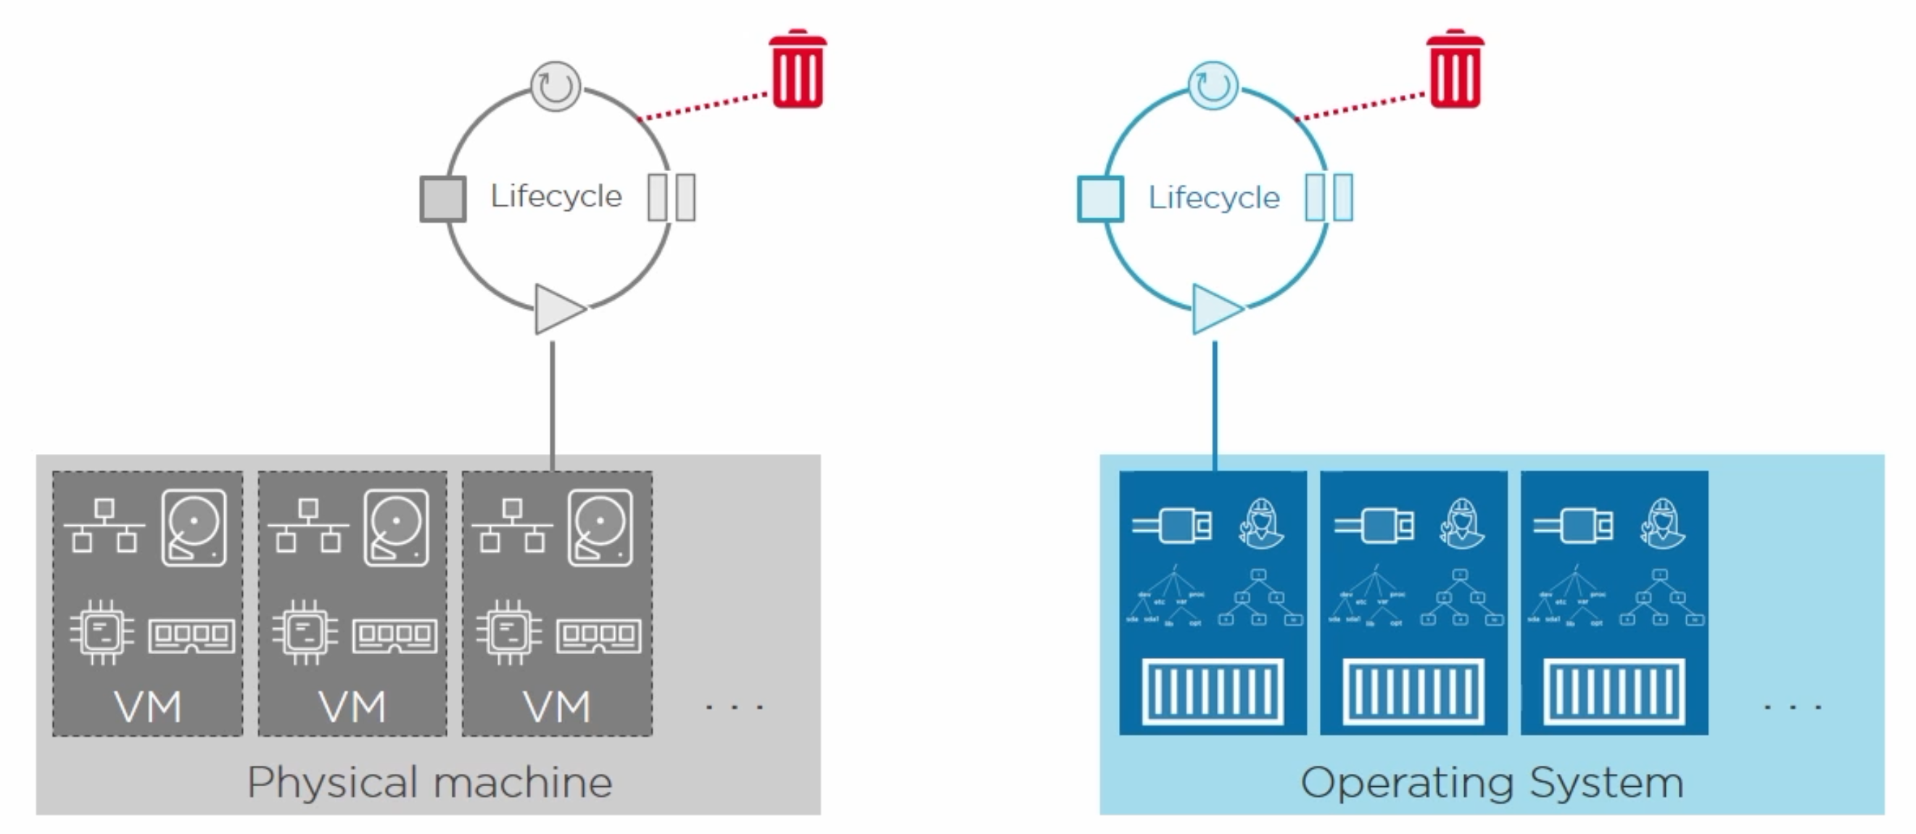
Pull Manifest
Pull Layers
Containers

Slide 36
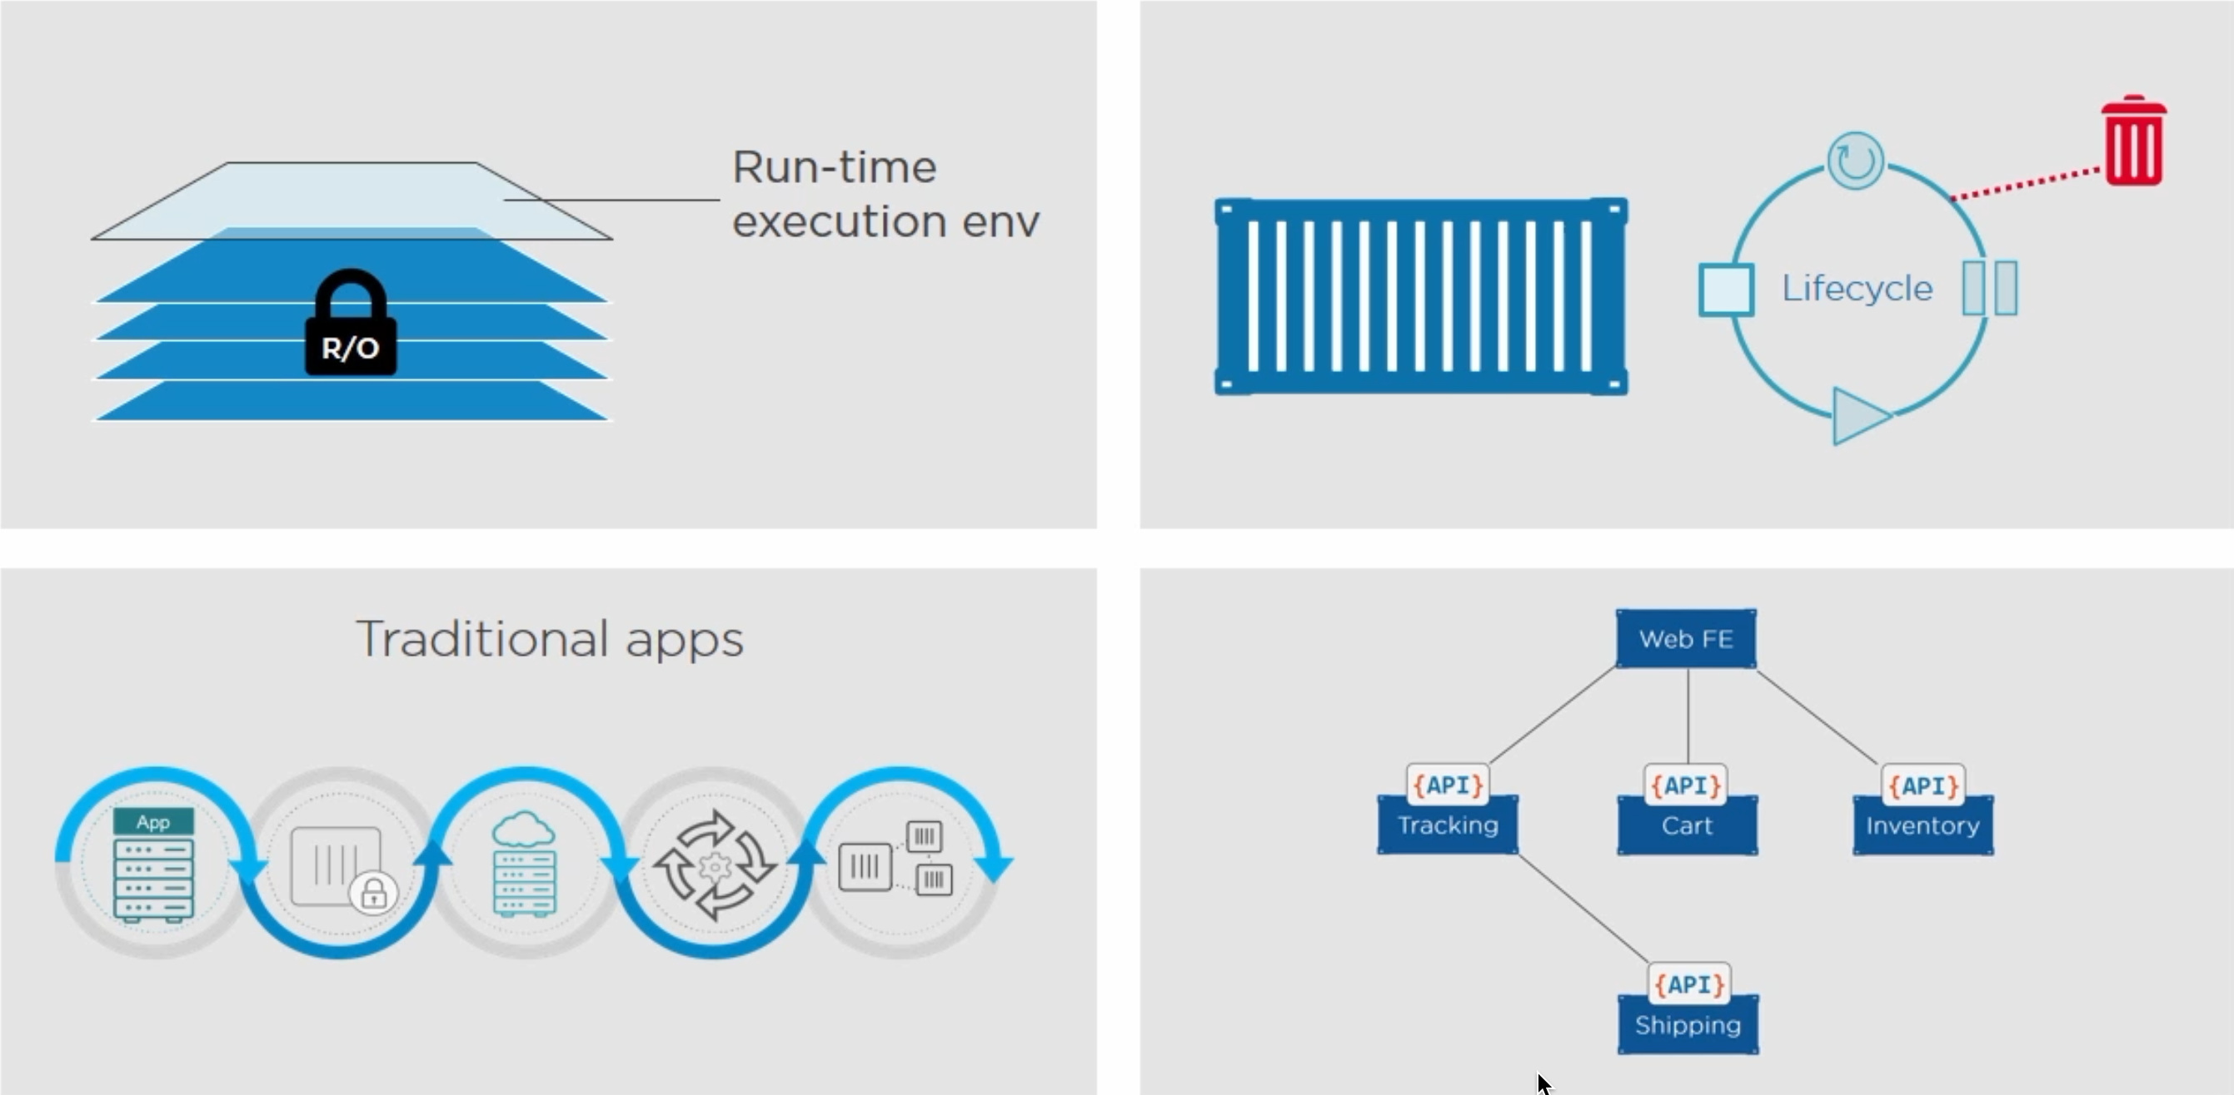
Pull Manifest
Pull Layers
Containers

Slide 37
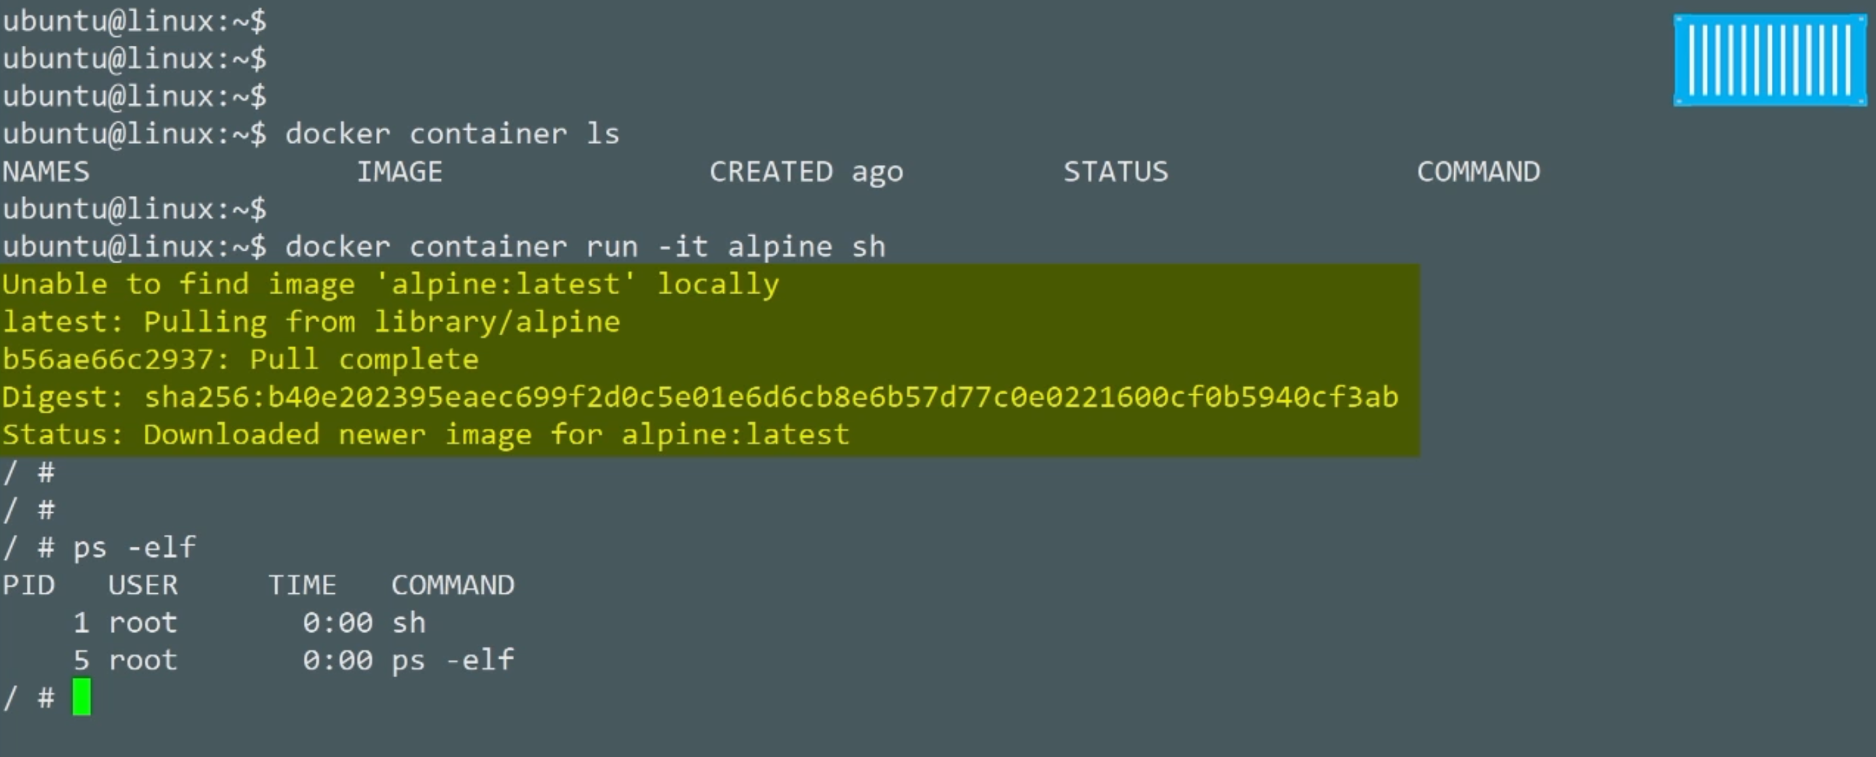
Pull Manifest
Pull Layers
Containers

Slide 38
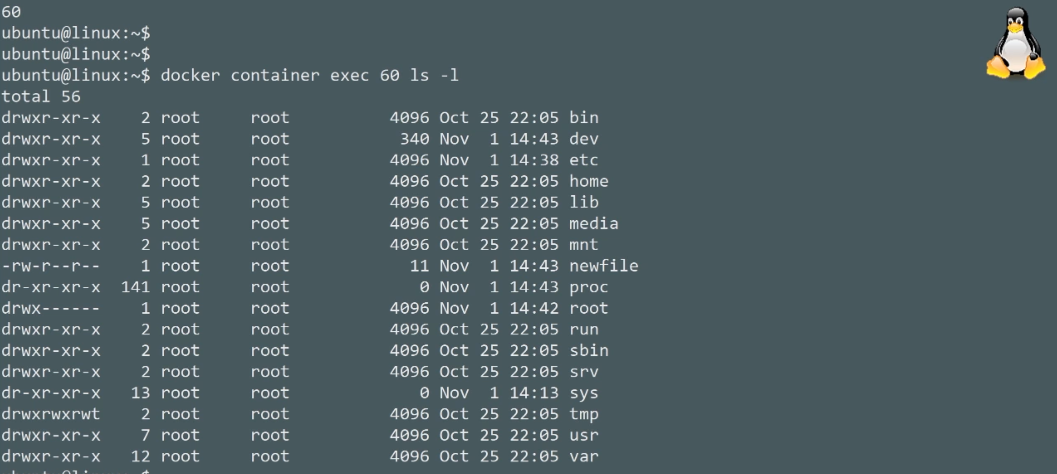
Pull Manifest
Pull Layers
Containers

Slide 39
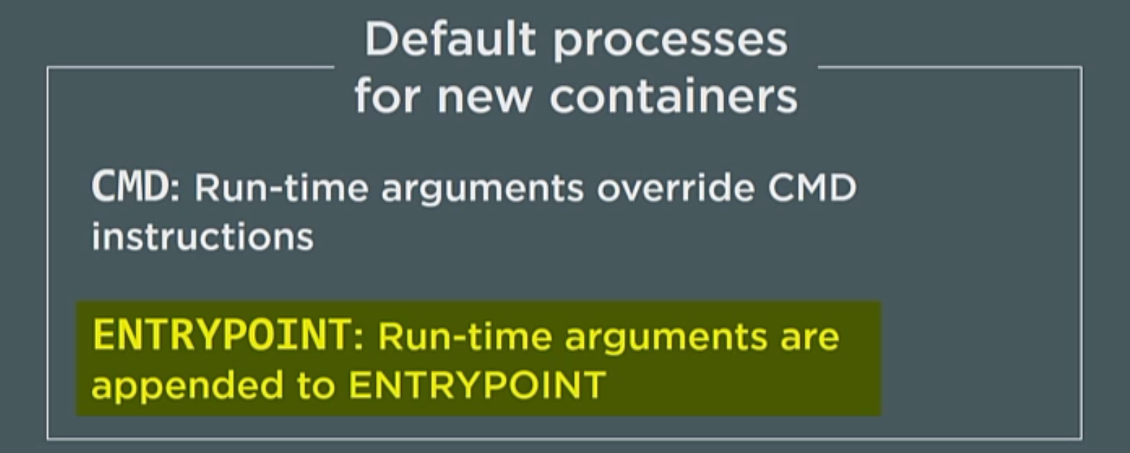
Pull Manifest
Pull Layers
Containers

Slide 40
Logging
Devops.Course

Slide 41
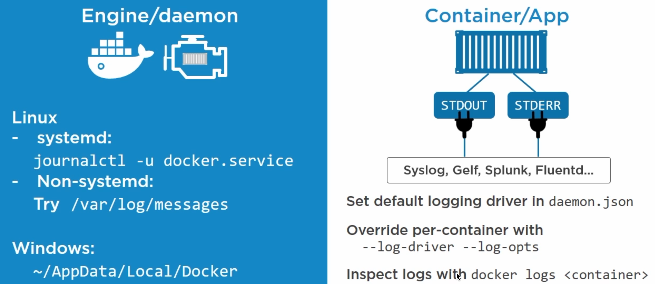
Pull Manifest
Pull Layers
Logging

Slide 42
Main Commands
Devops.Course

Slide 43
Main Docker Commands
docker pull <image_name>
docker images
docker ps -a
docker rm <id/container_name>
docker run --name <name> -dp <port#>:<port#> <image_name>
docker exec -it <name> <command>
Devops.Events

Slide 44
Main Docker Commands
docker stop <container_name>
docker rm <id/container_name>
docker rmi <image_name>
docker rm $(docker ps -q -f status=exited)
Devops.Events

Slide 45
docker-compose
Devops.Events

Slide 46
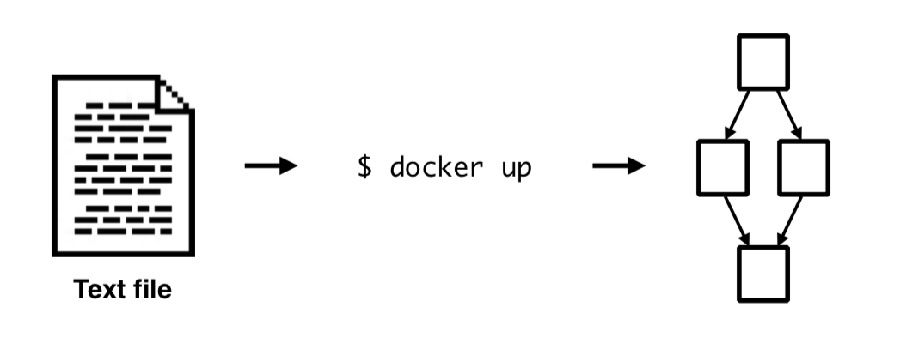
Docker Compose
Devops.Events

Slide 47
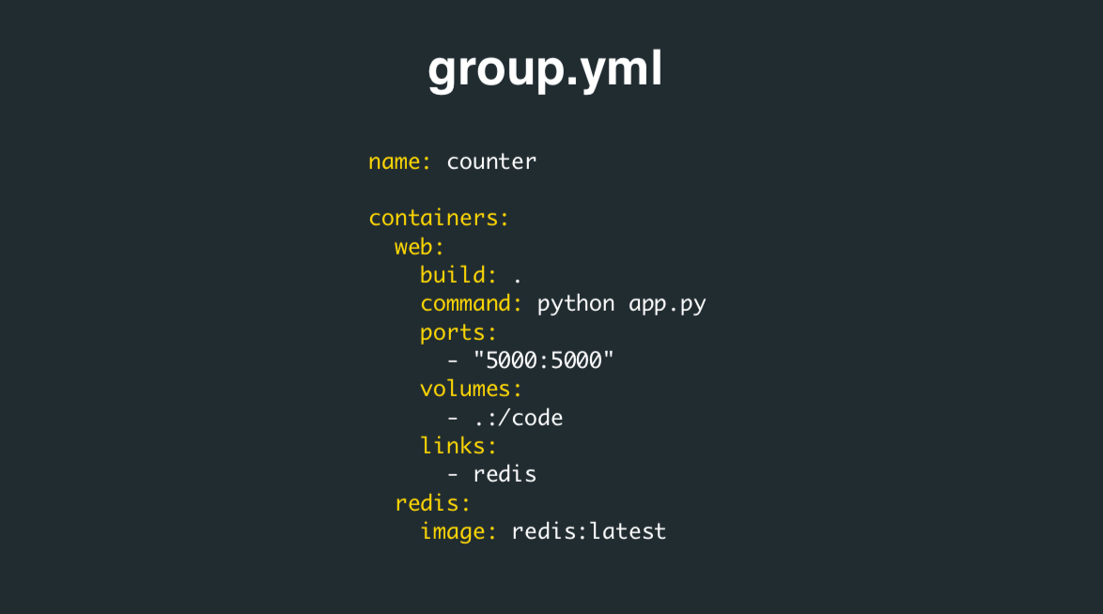
Docker Compose
Devops.Events

Slide 48
Main Docker Commands
docker-compose up -d —no-deps
docker-compose down -t <time_in_sec>
docker-compose rm
exec <name> COMMAND [ARGS...]
docker-compose rm <id/container_name>
docker-compose restart -t <time_in_sec>
Devops.Events

Slide 49

Questions ?
Devops.Course

Slide 50
Thanks for attentions!
Devops.Course

